Slide 1
dendroTools R package
Jernej Jevšenak
Brasov, June 4, 2024

Slide 2

HELLO!
I am Jernej Jevšenak
"Inspired by tree-rings, forest modelling and remote sensing"
jernej.jevsenak@gozdis.si

Slide 3
dendroTools R package
Functions for studying statistical relationships between tree-rings and climate data with daily and monthly resolution
Functions for comparing different regression methods for climate reconstructions (not in the scope of our workshop)

Slide 4
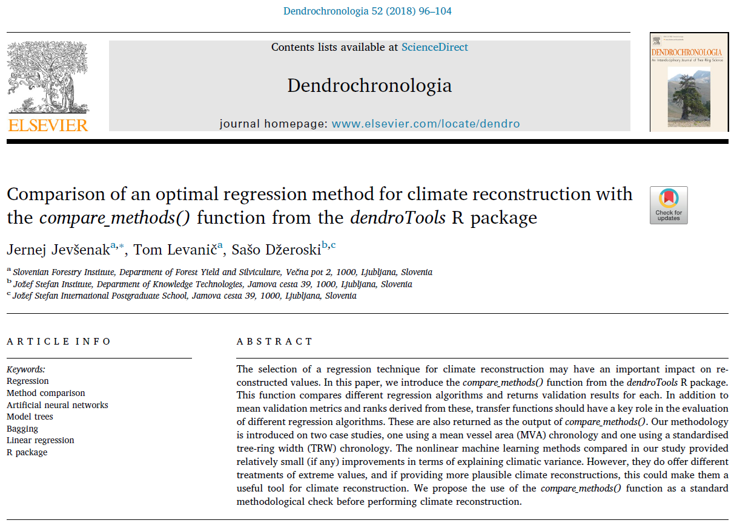

Slide 5
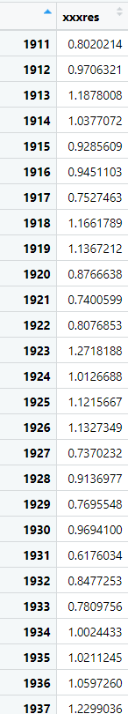
The correlation analyses with the dendroTools – key arguments
daily_response()
- response
monthly_response()
- response

Slide 6
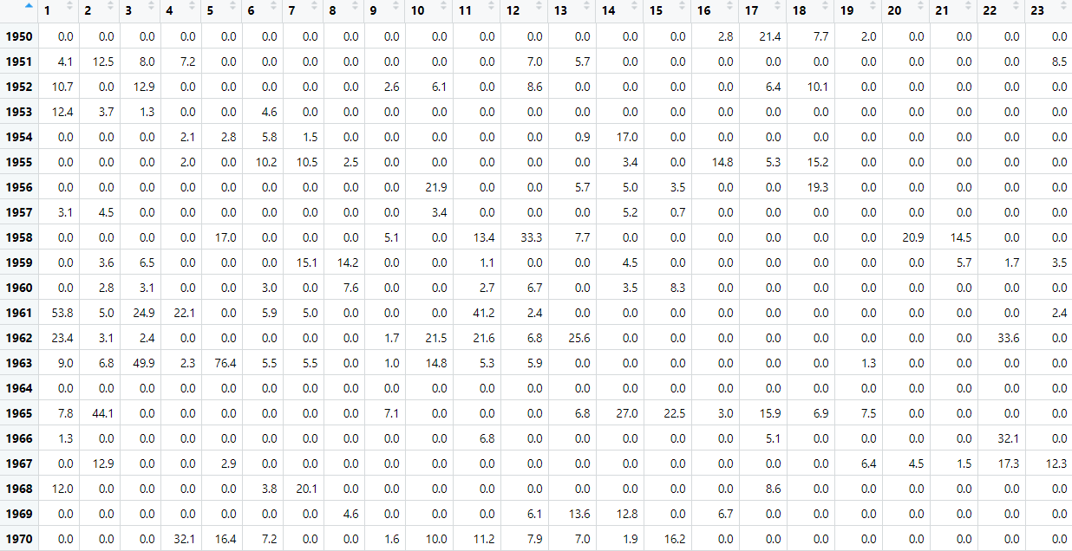
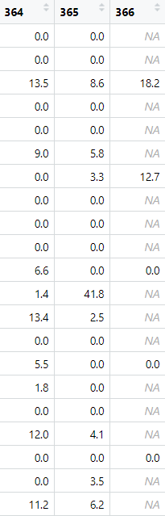
The correlation analyses with the dendroTools – key arguments
daily_response()
- env_data {366 days X n years}
monthly_response()
- env_data

Slide 7
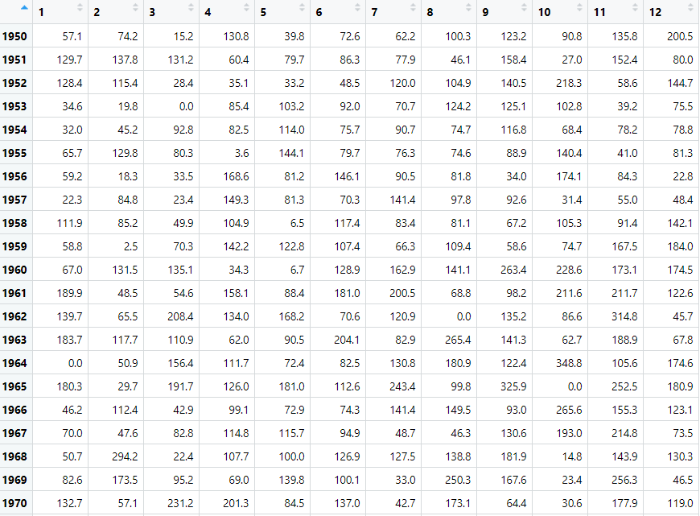
The correlation analyses with the dendroTools – key arguments
daily_response()
- env_data {366 days X n years}
monthly_response()
- env_data {12 months x N years}

Slide 8
The correlation analyses with the dendroTools – key arguments
daily_response()
- response
- env_data
- method ('cor' , 'brnn' , 'lm‘)
- cor_method ('pearson', 'spearman', 'kendall‘)
- previous_year (TRUE / FALSE)
- upper_limit / lower_limit
- remove_insignificant
monthly_response()
- response
- env_data
- method ('cor' , 'brnn' , 'lm‘)
- cor_method ('pearson', 'spearman', 'kendall')
- previous_year (TRUE / FALSE)
- upper_limit / lower_limit
- remove_insignificant

Slide 9
The correlation analyses with the dendroTools – additional arguments
daily_response()
- day_interval
- row_names_subset
monthly_response()
- month_interval
- row_names_subset

Slide 10
Exercise 1
Compare daily and monthly correlations

Slide 11
The algorithm for calculation of monthly correlations

Slide 12
Climate (precipitation) data
Tree-ring index
Year | 1 | 2 | 3 | 4 | 5 | 6 | 7 | 8 | 9 | 10 | 11 | 12
1950 | 57 | 74 | 15 | 131 | 40 | 73 | 62 | 100 | 123 | 91 | 136 | 201
1951 | 130 | 138 | 131 | 60 | 80 | 86 | 78 | 46 | 158 | 27 | 152 | 80
1952 | 128 | 115 | 28 | 35 | 33 | 49 | 120 | 105 | 141 | 218 | 59 | 145
1953 | 35 | 20 | 0 | 85 | 103 | 92 | 71 | 124 | 125 | 103 | 39 | 76
1954 | 32 | 45 | 93 | 83 | 114 | 76 | 91 | 75 | 117 | 68 | 78 | 79
1955 | 66 | 130 | 80 | 4 | 144 | 80 | 76 | 75 | 89 | 140 | 41 | 81
… | … | … | … | … | … | … | … | … | … | … | … | …
2007 | 107 | 201 | 72 | 0 | 167 | 80 | 75 | 110 | 219 | 83 | 46 | 46
2008 | 120 | 42 | 107 | 192 | 62 | 87 | 174 | 131 | 37 | 97 | 157 | 229
2009 | 67 | 98 | 224 | 53 | 38 | 106 | 108 | 108 | 72 | 138 | 196 | 294
2010 | 99 | 146 | 60 | 49 | 180 | 135 | 149 | 92 | 428 | 100 | 316 | 264
2011 | 60 | 27 | 134 | 22 | 90 | 144 | 159 | 17 | 85 | 120 | 4 | 154
2012 | 33 | 19 | 10 | 125 | 95 | 80 | 24 | 48 | 159 | 242 | 142 | 131
2013 | 148 | 132 | 315 | 57 | 281 | 112 | 38 | 132 | 207 | 109 | 227 | 48
2014 | 262 | 280 | 45 | 120 | 107 | 91 | 272 | 163 | 165 | 99 | 239 | 100
2015 | 64 | 25 | 74 | 37 | 61 | 95 | 76 | 154 | 112 | 215 | 32 | 1
2016 | 149 | 283 | 68 | 70 | 161 | 171 | 66 | 44 | 140 | 212 | 250 | 0
2017 | 121 | 168 | 38 | 114 | 61 | 106 | 14 | 64 | 315 | 65 | 234 | 274
2018 | 92 | 94 | 147 | 64 | 92 | 126 | 96 | 142 | 55 | 142 | 98 | 55
2019 | 62 | 116 | 24 | 96 | 186 | 36 | 99 | 71 | 138 | 60 | 337 | 185
2020 | 24 | 43 | 102 | 17 | 87 | 225 | 67 | 149 | 164 | 175 | 51 | 264
Year | xxxres
1950 | 0.832574
1951 | 0.773547
1952 | 0.802538
1953 | 1.187925
1954 | 0.805322
1955 | 1.070598
… | …
2007 | 1.065947
2008 | 1.25593
2009 | 0.792385
2010 | 0.892232
2011 | 1.032739
2012 | 0.823726
2013 | 0.767191
2014 | 1.527352
2015 | 0.929998
2016 | 1.050544
2017 | 0.687902
2018 | 0.998284
2019 | 0.97128
2020 | 1.375464
Output matrix
with correlation
Coefficients.

Slide 13
Climate (precipitation) data
Tree-ring index
Year | 1 | 2 | 3 | 4 | 5 | 6 | 7 | 8 | 9 | 10 | 11 | 12
1950 | 57 | 74 | 15 | 131 | 40 | 73 | 62 | 100 | 123 | 91 | 136 | 201
1951 | 130 | 138 | 131 | 60 | 80 | 86 | 78 | 46 | 158 | 27 | 152 | 80
1952 | 128 | 115 | 28 | 35 | 33 | 49 | 120 | 105 | 141 | 218 | 59 | 145
1953 | 35 | 20 | 0 | 85 | 103 | 92 | 71 | 124 | 125 | 103 | 39 | 76
1954 | 32 | 45 | 93 | 83 | 114 | 76 | 91 | 75 | 117 | 68 | 78 | 79
1955 | 66 | 130 | 80 | 4 | 144 | 80 | 76 | 75 | 89 | 140 | 41 | 81
… | … | … | … | … | … | … | … | … | … | … | … | …
2007 | 107 | 201 | 72 | 0 | 167 | 80 | 75 | 110 | 219 | 83 | 46 | 46
2008 | 120 | 42 | 107 | 192 | 62 | 87 | 174 | 131 | 37 | 97 | 157 | 229
2009 | 67 | 98 | 224 | 53 | 38 | 106 | 108 | 108 | 72 | 138 | 196 | 294
2010 | 99 | 146 | 60 | 49 | 180 | 135 | 149 | 92 | 428 | 100 | 316 | 264
2011 | 60 | 27 | 134 | 22 | 90 | 144 | 159 | 17 | 85 | 120 | 4 | 154
2012 | 33 | 19 | 10 | 125 | 95 | 80 | 24 | 48 | 159 | 242 | 142 | 131
2013 | 148 | 132 | 315 | 57 | 281 | 112 | 38 | 132 | 207 | 109 | 227 | 48
2014 | 262 | 280 | 45 | 120 | 107 | 91 | 272 | 163 | 165 | 99 | 239 | 100
2015 | 64 | 25 | 74 | 37 | 61 | 95 | 76 | 154 | 112 | 215 | 32 | 1
2016 | 149 | 283 | 68 | 70 | 161 | 171 | 66 | 44 | 140 | 212 | 250 | 0
2017 | 121 | 168 | 38 | 114 | 61 | 106 | 14 | 64 | 315 | 65 | 234 | 274
2018 | 92 | 94 | 147 | 64 | 92 | 126 | 96 | 142 | 55 | 142 | 98 | 55
2019 | 62 | 116 | 24 | 96 | 186 | 36 | 99 | 71 | 138 | 60 | 337 | 185
2020 | 24 | 43 | 102 | 17 | 87 | 225 | 67 | 149 | 164 | 175 | 51 | 264
Year | xxxres
1950 | 0.832574
1951 | 0.773547
1952 | 0.802538
1953 | 1.187925
1954 | 0.805322
1955 | 1.070598
… | …
2007 | 1.065947
2008 | 1.25593
2009 | 0.792385
2010 | 0.892232
2011 | 1.032739
2012 | 0.823726
2013 | 0.767191
2014 | 1.527352
2015 | 0.929998
2016 | 1.050544
2017 | 0.687902
2018 | 0.998284
2019 | 0.97128
2020 | 1.375464
1 | 0.21
Output matrix
with correlation
Coefficients.

Slide 14
Climate (precipitation) data
Tree-ring index
Year | 1 | 2 | 3 | 4 | 5 | 6 | 7 | 8 | 9 | 10 | 11 | 12
1950 | 57 | 74 | 15 | 131 | 40 | 73 | 62 | 100 | 123 | 91 | 136 | 201
1951 | 130 | 138 | 131 | 60 | 80 | 86 | 78 | 46 | 158 | 27 | 152 | 80
1952 | 128 | 115 | 28 | 35 | 33 | 49 | 120 | 105 | 141 | 218 | 59 | 145
1953 | 35 | 20 | 0 | 85 | 103 | 92 | 71 | 124 | 125 | 103 | 39 | 76
1954 | 32 | 45 | 93 | 83 | 114 | 76 | 91 | 75 | 117 | 68 | 78 | 79
1955 | 66 | 130 | 80 | 4 | 144 | 80 | 76 | 75 | 89 | 140 | 41 | 81
… | … | … | … | … | … | … | … | … | … | … | … | …
2007 | 107 | 201 | 72 | 0 | 167 | 80 | 75 | 110 | 219 | 83 | 46 | 46
2008 | 120 | 42 | 107 | 192 | 62 | 87 | 174 | 131 | 37 | 97 | 157 | 229
2009 | 67 | 98 | 224 | 53 | 38 | 106 | 108 | 108 | 72 | 138 | 196 | 294
2010 | 99 | 146 | 60 | 49 | 180 | 135 | 149 | 92 | 428 | 100 | 316 | 264
2011 | 60 | 27 | 134 | 22 | 90 | 144 | 159 | 17 | 85 | 120 | 4 | 154
2012 | 33 | 19 | 10 | 125 | 95 | 80 | 24 | 48 | 159 | 242 | 142 | 131
2013 | 148 | 132 | 315 | 57 | 281 | 112 | 38 | 132 | 207 | 109 | 227 | 48
2014 | 262 | 280 | 45 | 120 | 107 | 91 | 272 | 163 | 165 | 99 | 239 | 100
2015 | 64 | 25 | 74 | 37 | 61 | 95 | 76 | 154 | 112 | 215 | 32 | 1
2016 | 149 | 283 | 68 | 70 | 161 | 171 | 66 | 44 | 140 | 212 | 250 | 0
2017 | 121 | 168 | 38 | 114 | 61 | 106 | 14 | 64 | 315 | 65 | 234 | 274
2018 | 92 | 94 | 147 | 64 | 92 | 126 | 96 | 142 | 55 | 142 | 98 | 55
2019 | 62 | 116 | 24 | 96 | 186 | 36 | 99 | 71 | 138 | 60 | 337 | 185
2020 | 24 | 43 | 102 | 17 | 87 | 225 | 67 | 149 | 164 | 175 | 51 | 264
Year | xxxres
1950 | 0.832574
1951 | 0.773547
1952 | 0.802538
1953 | 1.187925
1954 | 0.805322
1955 | 1.070598
… | …
2007 | 1.065947
2008 | 1.25593
2009 | 0.792385
2010 | 0.892232
2011 | 1.032739
2012 | 0.823726
2013 | 0.767191
2014 | 1.527352
2015 | 0.929998
2016 | 1.050544
2017 | 0.687902
2018 | 0.998284
2019 | 0.97128
2020 | 1.375464
1 | 0.21 | 0.05
Output matrix
with correlation
Coefficients.

Slide 15
Climate (precipitation) data
Tree-ring index
Year | 1 | 2 | 3 | 4 | 5 | 6 | 7 | 8 | 9 | 10 | 11 | 12
1950 | 57 | 74 | 15 | 131 | 40 | 73 | 62 | 100 | 123 | 91 | 136 | 201
1951 | 130 | 138 | 131 | 60 | 80 | 86 | 78 | 46 | 158 | 27 | 152 | 80
1952 | 128 | 115 | 28 | 35 | 33 | 49 | 120 | 105 | 141 | 218 | 59 | 145
1953 | 35 | 20 | 0 | 85 | 103 | 92 | 71 | 124 | 125 | 103 | 39 | 76
1954 | 32 | 45 | 93 | 83 | 114 | 76 | 91 | 75 | 117 | 68 | 78 | 79
1955 | 66 | 130 | 80 | 4 | 144 | 80 | 76 | 75 | 89 | 140 | 41 | 81
… | … | … | … | … | … | … | … | … | … | … | … | …
2007 | 107 | 201 | 72 | 0 | 167 | 80 | 75 | 110 | 219 | 83 | 46 | 46
2008 | 120 | 42 | 107 | 192 | 62 | 87 | 174 | 131 | 37 | 97 | 157 | 229
2009 | 67 | 98 | 224 | 53 | 38 | 106 | 108 | 108 | 72 | 138 | 196 | 294
2010 | 99 | 146 | 60 | 49 | 180 | 135 | 149 | 92 | 428 | 100 | 316 | 264
2011 | 60 | 27 | 134 | 22 | 90 | 144 | 159 | 17 | 85 | 120 | 4 | 154
2012 | 33 | 19 | 10 | 125 | 95 | 80 | 24 | 48 | 159 | 242 | 142 | 131
2013 | 148 | 132 | 315 | 57 | 281 | 112 | 38 | 132 | 207 | 109 | 227 | 48
2014 | 262 | 280 | 45 | 120 | 107 | 91 | 272 | 163 | 165 | 99 | 239 | 100
2015 | 64 | 25 | 74 | 37 | 61 | 95 | 76 | 154 | 112 | 215 | 32 | 1
2016 | 149 | 283 | 68 | 70 | 161 | 171 | 66 | 44 | 140 | 212 | 250 | 0
2017 | 121 | 168 | 38 | 114 | 61 | 106 | 14 | 64 | 315 | 65 | 234 | 274
2018 | 92 | 94 | 147 | 64 | 92 | 126 | 96 | 142 | 55 | 142 | 98 | 55
2019 | 62 | 116 | 24 | 96 | 186 | 36 | 99 | 71 | 138 | 60 | 337 | 185
2020 | 24 | 43 | 102 | 17 | 87 | 225 | 67 | 149 | 164 | 175 | 51 | 264
Year | xxxres
1950 | 0.832574
1951 | 0.773547
1952 | 0.802538
1953 | 1.187925
1954 | 0.805322
1955 | 1.070598
… | …
2007 | 1.065947
2008 | 1.25593
2009 | 0.792385
2010 | 0.892232
2011 | 1.032739
2012 | 0.823726
2013 | 0.767191
2014 | 1.527352
2015 | 0.929998
2016 | 1.050544
2017 | 0.687902
2018 | 0.998284
2019 | 0.97128
2020 | 1.375464
1 | 0.21 | 0.05 | 0.02
Output matrix
with correlation
Coefficients.

Slide 16
Climate (precipitation) data
Tree-ring index
Year | 1 | 2 | 3 | 4 | 5 | 6 | 7 | 8 | 9 | 10 | 11 | 12
1950 | 57 | 74 | 15 | 131 | 40 | 73 | 62 | 100 | 123 | 91 | 136 | 201
1951 | 130 | 138 | 131 | 60 | 80 | 86 | 78 | 46 | 158 | 27 | 152 | 80
1952 | 128 | 115 | 28 | 35 | 33 | 49 | 120 | 105 | 141 | 218 | 59 | 145
1953 | 35 | 20 | 0 | 85 | 103 | 92 | 71 | 124 | 125 | 103 | 39 | 76
1954 | 32 | 45 | 93 | 83 | 114 | 76 | 91 | 75 | 117 | 68 | 78 | 79
1955 | 66 | 130 | 80 | 4 | 144 | 80 | 76 | 75 | 89 | 140 | 41 | 81
… | … | … | … | … | … | … | … | … | … | … | … | …
2007 | 107 | 201 | 72 | 0 | 167 | 80 | 75 | 110 | 219 | 83 | 46 | 46
2008 | 120 | 42 | 107 | 192 | 62 | 87 | 174 | 131 | 37 | 97 | 157 | 229
2009 | 67 | 98 | 224 | 53 | 38 | 106 | 108 | 108 | 72 | 138 | 196 | 294
2010 | 99 | 146 | 60 | 49 | 180 | 135 | 149 | 92 | 428 | 100 | 316 | 264
2011 | 60 | 27 | 134 | 22 | 90 | 144 | 159 | 17 | 85 | 120 | 4 | 154
2012 | 33 | 19 | 10 | 125 | 95 | 80 | 24 | 48 | 159 | 242 | 142 | 131
2013 | 148 | 132 | 315 | 57 | 281 | 112 | 38 | 132 | 207 | 109 | 227 | 48
2014 | 262 | 280 | 45 | 120 | 107 | 91 | 272 | 163 | 165 | 99 | 239 | 100
2015 | 64 | 25 | 74 | 37 | 61 | 95 | 76 | 154 | 112 | 215 | 32 | 1
2016 | 149 | 283 | 68 | 70 | 161 | 171 | 66 | 44 | 140 | 212 | 250 | 0
2017 | 121 | 168 | 38 | 114 | 61 | 106 | 14 | 64 | 315 | 65 | 234 | 274
2018 | 92 | 94 | 147 | 64 | 92 | 126 | 96 | 142 | 55 | 142 | 98 | 55
2019 | 62 | 116 | 24 | 96 | 186 | 36 | 99 | 71 | 138 | 60 | 337 | 185
2020 | 24 | 43 | 102 | 17 | 87 | 225 | 67 | 149 | 164 | 175 | 51 | 264
Year | xxxres
1950 | 0.832574
1951 | 0.773547
1952 | 0.802538
1953 | 1.187925
1954 | 0.805322
1955 | 1.070598
… | …
2007 | 1.065947
2008 | 1.25593
2009 | 0.792385
2010 | 0.892232
2011 | 1.032739
2012 | 0.823726
2013 | 0.767191
2014 | 1.527352
2015 | 0.929998
2016 | 1.050544
2017 | 0.687902
2018 | 0.998284
2019 | 0.97128
2020 | 1.375464
1 | 0.21 | 0.05 | 0.02 | 0.09
Output matrix
with correlation
Coefficients.

Slide 17
Climate (precipitation) data
Tree-ring index
Year | 1 | 2 | 3 | 4 | 5 | 6 | 7 | 8 | 9 | 10 | 11 | 12
1950 | 57 | 74 | 15 | 131 | 40 | 73 | 62 | 100 | 123 | 91 | 136 | 201
1951 | 130 | 138 | 131 | 60 | 80 | 86 | 78 | 46 | 158 | 27 | 152 | 80
1952 | 128 | 115 | 28 | 35 | 33 | 49 | 120 | 105 | 141 | 218 | 59 | 145
1953 | 35 | 20 | 0 | 85 | 103 | 92 | 71 | 124 | 125 | 103 | 39 | 76
1954 | 32 | 45 | 93 | 83 | 114 | 76 | 91 | 75 | 117 | 68 | 78 | 79
1955 | 66 | 130 | 80 | 4 | 144 | 80 | 76 | 75 | 89 | 140 | 41 | 81
… | … | … | … | … | … | … | … | … | … | … | … | …
2007 | 107 | 201 | 72 | 0 | 167 | 80 | 75 | 110 | 219 | 83 | 46 | 46
2008 | 120 | 42 | 107 | 192 | 62 | 87 | 174 | 131 | 37 | 97 | 157 | 229
2009 | 67 | 98 | 224 | 53 | 38 | 106 | 108 | 108 | 72 | 138 | 196 | 294
2010 | 99 | 146 | 60 | 49 | 180 | 135 | 149 | 92 | 428 | 100 | 316 | 264
2011 | 60 | 27 | 134 | 22 | 90 | 144 | 159 | 17 | 85 | 120 | 4 | 154
2012 | 33 | 19 | 10 | 125 | 95 | 80 | 24 | 48 | 159 | 242 | 142 | 131
2013 | 148 | 132 | 315 | 57 | 281 | 112 | 38 | 132 | 207 | 109 | 227 | 48
2014 | 262 | 280 | 45 | 120 | 107 | 91 | 272 | 163 | 165 | 99 | 239 | 100
2015 | 64 | 25 | 74 | 37 | 61 | 95 | 76 | 154 | 112 | 215 | 32 | 1
2016 | 149 | 283 | 68 | 70 | 161 | 171 | 66 | 44 | 140 | 212 | 250 | 0
2017 | 121 | 168 | 38 | 114 | 61 | 106 | 14 | 64 | 315 | 65 | 234 | 274
2018 | 92 | 94 | 147 | 64 | 92 | 126 | 96 | 142 | 55 | 142 | 98 | 55
2019 | 62 | 116 | 24 | 96 | 186 | 36 | 99 | 71 | 138 | 60 | 337 | 185
2020 | 24 | 43 | 102 | 17 | 87 | 225 | 67 | 149 | 164 | 175 | 51 | 264
Year | xxxres
1950 | 0.832574
1951 | 0.773547
1952 | 0.802538
1953 | 1.187925
1954 | 0.805322
1955 | 1.070598
… | …
2007 | 1.065947
2008 | 1.25593
2009 | 0.792385
2010 | 0.892232
2011 | 1.032739
2012 | 0.823726
2013 | 0.767191
2014 | 1.527352
2015 | 0.929998
2016 | 1.050544
2017 | 0.687902
2018 | 0.998284
2019 | 0.97128
2020 | 1.375464
1 | 0.21 | 0.05 | 0.02 | 0.09 | 0.17
Output matrix
with correlation
Coefficients.

Slide 18
Climate (precipitation) data
Tree-ring index
Year | 1 | 2 | 3 | 4 | 5 | 6 | 7 | 8 | 9 | 10 | 11 | 12
1950 | 57 | 74 | 15 | 131 | 40 | 73 | 62 | 100 | 123 | 91 | 136 | 201
1951 | 130 | 138 | 131 | 60 | 80 | 86 | 78 | 46 | 158 | 27 | 152 | 80
1952 | 128 | 115 | 28 | 35 | 33 | 49 | 120 | 105 | 141 | 218 | 59 | 145
1953 | 35 | 20 | 0 | 85 | 103 | 92 | 71 | 124 | 125 | 103 | 39 | 76
1954 | 32 | 45 | 93 | 83 | 114 | 76 | 91 | 75 | 117 | 68 | 78 | 79
1955 | 66 | 130 | 80 | 4 | 144 | 80 | 76 | 75 | 89 | 140 | 41 | 81
… | … | … | … | … | … | … | … | … | … | … | … | …
2007 | 107 | 201 | 72 | 0 | 167 | 80 | 75 | 110 | 219 | 83 | 46 | 46
2008 | 120 | 42 | 107 | 192 | 62 | 87 | 174 | 131 | 37 | 97 | 157 | 229
2009 | 67 | 98 | 224 | 53 | 38 | 106 | 108 | 108 | 72 | 138 | 196 | 294
2010 | 99 | 146 | 60 | 49 | 180 | 135 | 149 | 92 | 428 | 100 | 316 | 264
2011 | 60 | 27 | 134 | 22 | 90 | 144 | 159 | 17 | 85 | 120 | 4 | 154
2012 | 33 | 19 | 10 | 125 | 95 | 80 | 24 | 48 | 159 | 242 | 142 | 131
2013 | 148 | 132 | 315 | 57 | 281 | 112 | 38 | 132 | 207 | 109 | 227 | 48
2014 | 262 | 280 | 45 | 120 | 107 | 91 | 272 | 163 | 165 | 99 | 239 | 100
2015 | 64 | 25 | 74 | 37 | 61 | 95 | 76 | 154 | 112 | 215 | 32 | 1
2016 | 149 | 283 | 68 | 70 | 161 | 171 | 66 | 44 | 140 | 212 | 250 | 0
2017 | 121 | 168 | 38 | 114 | 61 | 106 | 14 | 64 | 315 | 65 | 234 | 274
2018 | 92 | 94 | 147 | 64 | 92 | 126 | 96 | 142 | 55 | 142 | 98 | 55
2019 | 62 | 116 | 24 | 96 | 186 | 36 | 99 | 71 | 138 | 60 | 337 | 185
2020 | 24 | 43 | 102 | 17 | 87 | 225 | 67 | 149 | 164 | 175 | 51 | 264
Year | xxxres
1950 | 0.832574
1951 | 0.773547
1952 | 0.802538
1953 | 1.187925
1954 | 0.805322
1955 | 1.070598
… | …
2007 | 1.065947
2008 | 1.25593
2009 | 0.792385
2010 | 0.892232
2011 | 1.032739
2012 | 0.823726
2013 | 0.767191
2014 | 1.527352
2015 | 0.929998
2016 | 1.050544
2017 | 0.687902
2018 | 0.998284
2019 | 0.97128
2020 | 1.375464
1 | 0.21 | 0.05 | 0.02 | 0.09 | 0.17 | 0.36
Output matrix
with correlation
Coefficients.

Slide 19
Climate (precipitation) data
Tree-ring index
Year | 1 | 2 | 3 | 4 | 5 | 6 | 7 | 8 | 9 | 10 | 11 | 12
1950 | 57 | 74 | 15 | 131 | 40 | 73 | 62 | 100 | 123 | 91 | 136 | 201
1951 | 130 | 138 | 131 | 60 | 80 | 86 | 78 | 46 | 158 | 27 | 152 | 80
1952 | 128 | 115 | 28 | 35 | 33 | 49 | 120 | 105 | 141 | 218 | 59 | 145
1953 | 35 | 20 | 0 | 85 | 103 | 92 | 71 | 124 | 125 | 103 | 39 | 76
1954 | 32 | 45 | 93 | 83 | 114 | 76 | 91 | 75 | 117 | 68 | 78 | 79
1955 | 66 | 130 | 80 | 4 | 144 | 80 | 76 | 75 | 89 | 140 | 41 | 81
… | … | … | … | … | … | … | … | … | … | … | … | …
2007 | 107 | 201 | 72 | 0 | 167 | 80 | 75 | 110 | 219 | 83 | 46 | 46
2008 | 120 | 42 | 107 | 192 | 62 | 87 | 174 | 131 | 37 | 97 | 157 | 229
2009 | 67 | 98 | 224 | 53 | 38 | 106 | 108 | 108 | 72 | 138 | 196 | 294
2010 | 99 | 146 | 60 | 49 | 180 | 135 | 149 | 92 | 428 | 100 | 316 | 264
2011 | 60 | 27 | 134 | 22 | 90 | 144 | 159 | 17 | 85 | 120 | 4 | 154
2012 | 33 | 19 | 10 | 125 | 95 | 80 | 24 | 48 | 159 | 242 | 142 | 131
2013 | 148 | 132 | 315 | 57 | 281 | 112 | 38 | 132 | 207 | 109 | 227 | 48
2014 | 262 | 280 | 45 | 120 | 107 | 91 | 272 | 163 | 165 | 99 | 239 | 100
2015 | 64 | 25 | 74 | 37 | 61 | 95 | 76 | 154 | 112 | 215 | 32 | 1
2016 | 149 | 283 | 68 | 70 | 161 | 171 | 66 | 44 | 140 | 212 | 250 | 0
2017 | 121 | 168 | 38 | 114 | 61 | 106 | 14 | 64 | 315 | 65 | 234 | 274
2018 | 92 | 94 | 147 | 64 | 92 | 126 | 96 | 142 | 55 | 142 | 98 | 55
2019 | 62 | 116 | 24 | 96 | 186 | 36 | 99 | 71 | 138 | 60 | 337 | 185
2020 | 24 | 43 | 102 | 17 | 87 | 225 | 67 | 149 | 164 | 175 | 51 | 264
Year | xxxres
1950 | 0.832574
1951 | 0.773547
1952 | 0.802538
1953 | 1.187925
1954 | 0.805322
1955 | 1.070598
… | …
2007 | 1.065947
2008 | 1.25593
2009 | 0.792385
2010 | 0.892232
2011 | 1.032739
2012 | 0.823726
2013 | 0.767191
2014 | 1.527352
2015 | 0.929998
2016 | 1.050544
2017 | 0.687902
2018 | 0.998284
2019 | 0.97128
2020 | 1.375464
1 | 0.21 | 0.05 | 0.02 | 0.09 | 0.17 | 0.36 | 0.44
Output matrix
with correlation
Coefficients.

Slide 20
Climate (precipitation) data
Tree-ring index
Year | 1 | 2 | 3 | 4 | 5 | 6 | 7 | 8 | 9 | 10 | 11 | 12
1950 | 57 | 74 | 15 | 131 | 40 | 73 | 62 | 100 | 123 | 91 | 136 | 201
1951 | 130 | 138 | 131 | 60 | 80 | 86 | 78 | 46 | 158 | 27 | 152 | 80
1952 | 128 | 115 | 28 | 35 | 33 | 49 | 120 | 105 | 141 | 218 | 59 | 145
1953 | 35 | 20 | 0 | 85 | 103 | 92 | 71 | 124 | 125 | 103 | 39 | 76
1954 | 32 | 45 | 93 | 83 | 114 | 76 | 91 | 75 | 117 | 68 | 78 | 79
1955 | 66 | 130 | 80 | 4 | 144 | 80 | 76 | 75 | 89 | 140 | 41 | 81
… | … | … | … | … | … | … | … | … | … | … | … | …
2007 | 107 | 201 | 72 | 0 | 167 | 80 | 75 | 110 | 219 | 83 | 46 | 46
2008 | 120 | 42 | 107 | 192 | 62 | 87 | 174 | 131 | 37 | 97 | 157 | 229
2009 | 67 | 98 | 224 | 53 | 38 | 106 | 108 | 108 | 72 | 138 | 196 | 294
2010 | 99 | 146 | 60 | 49 | 180 | 135 | 149 | 92 | 428 | 100 | 316 | 264
2011 | 60 | 27 | 134 | 22 | 90 | 144 | 159 | 17 | 85 | 120 | 4 | 154
2012 | 33 | 19 | 10 | 125 | 95 | 80 | 24 | 48 | 159 | 242 | 142 | 131
2013 | 148 | 132 | 315 | 57 | 281 | 112 | 38 | 132 | 207 | 109 | 227 | 48
2014 | 262 | 280 | 45 | 120 | 107 | 91 | 272 | 163 | 165 | 99 | 239 | 100
2015 | 64 | 25 | 74 | 37 | 61 | 95 | 76 | 154 | 112 | 215 | 32 | 1
2016 | 149 | 283 | 68 | 70 | 161 | 171 | 66 | 44 | 140 | 212 | 250 | 0
2017 | 121 | 168 | 38 | 114 | 61 | 106 | 14 | 64 | 315 | 65 | 234 | 274
2018 | 92 | 94 | 147 | 64 | 92 | 126 | 96 | 142 | 55 | 142 | 98 | 55
2019 | 62 | 116 | 24 | 96 | 186 | 36 | 99 | 71 | 138 | 60 | 337 | 185
2020 | 24 | 43 | 102 | 17 | 87 | 225 | 67 | 149 | 164 | 175 | 51 | 264
Year | xxxres
1950 | 0.832574
1951 | 0.773547
1952 | 0.802538
1953 | 1.187925
1954 | 0.805322
1955 | 1.070598
… | …
2007 | 1.065947
2008 | 1.25593
2009 | 0.792385
2010 | 0.892232
2011 | 1.032739
2012 | 0.823726
2013 | 0.767191
2014 | 1.527352
2015 | 0.929998
2016 | 1.050544
2017 | 0.687902
2018 | 0.998284
2019 | 0.97128
2020 | 1.375464
1 | 0.21 | 0.05 | 0.02 | 0.09 | 0.17 | 0.36 | 0.44 | 0.09
Output matrix
with correlation
Coefficients.

Slide 21
Climate (precipitation) data
Tree-ring index
Year | 1 | 2 | 3 | 4 | 5 | 6 | 7 | 8 | 9 | 10 | 11 | 12
1950 | 57 | 74 | 15 | 131 | 40 | 73 | 62 | 100 | 123 | 91 | 136 | 201
1951 | 130 | 138 | 131 | 60 | 80 | 86 | 78 | 46 | 158 | 27 | 152 | 80
1952 | 128 | 115 | 28 | 35 | 33 | 49 | 120 | 105 | 141 | 218 | 59 | 145
1953 | 35 | 20 | 0 | 85 | 103 | 92 | 71 | 124 | 125 | 103 | 39 | 76
1954 | 32 | 45 | 93 | 83 | 114 | 76 | 91 | 75 | 117 | 68 | 78 | 79
1955 | 66 | 130 | 80 | 4 | 144 | 80 | 76 | 75 | 89 | 140 | 41 | 81
… | … | … | … | … | … | … | … | … | … | … | … | …
2007 | 107 | 201 | 72 | 0 | 167 | 80 | 75 | 110 | 219 | 83 | 46 | 46
2008 | 120 | 42 | 107 | 192 | 62 | 87 | 174 | 131 | 37 | 97 | 157 | 229
2009 | 67 | 98 | 224 | 53 | 38 | 106 | 108 | 108 | 72 | 138 | 196 | 294
2010 | 99 | 146 | 60 | 49 | 180 | 135 | 149 | 92 | 428 | 100 | 316 | 264
2011 | 60 | 27 | 134 | 22 | 90 | 144 | 159 | 17 | 85 | 120 | 4 | 154
2012 | 33 | 19 | 10 | 125 | 95 | 80 | 24 | 48 | 159 | 242 | 142 | 131
2013 | 148 | 132 | 315 | 57 | 281 | 112 | 38 | 132 | 207 | 109 | 227 | 48
2014 | 262 | 280 | 45 | 120 | 107 | 91 | 272 | 163 | 165 | 99 | 239 | 100
2015 | 64 | 25 | 74 | 37 | 61 | 95 | 76 | 154 | 112 | 215 | 32 | 1
2016 | 149 | 283 | 68 | 70 | 161 | 171 | 66 | 44 | 140 | 212 | 250 | 0
2017 | 121 | 168 | 38 | 114 | 61 | 106 | 14 | 64 | 315 | 65 | 234 | 274
2018 | 92 | 94 | 147 | 64 | 92 | 126 | 96 | 142 | 55 | 142 | 98 | 55
2019 | 62 | 116 | 24 | 96 | 186 | 36 | 99 | 71 | 138 | 60 | 337 | 185
2020 | 24 | 43 | 102 | 17 | 87 | 225 | 67 | 149 | 164 | 175 | 51 | 264
Year | xxxres
1950 | 0.832574
1951 | 0.773547
1952 | 0.802538
1953 | 1.187925
1954 | 0.805322
1955 | 1.070598
… | …
2007 | 1.065947
2008 | 1.25593
2009 | 0.792385
2010 | 0.892232
2011 | 1.032739
2012 | 0.823726
2013 | 0.767191
2014 | 1.527352
2015 | 0.929998
2016 | 1.050544
2017 | 0.687902
2018 | 0.998284
2019 | 0.97128
2020 | 1.375464
1 | 0.21 | 0.05 | 0.02 | 0.09 | 0.17 | 0.36 | 0.44 | 0.09 | -0.13
Output matrix
with correlation
Coefficients.

Slide 22
Climate (precipitation) data
Tree-ring index
Year | 1 | 2 | 3 | 4 | 5 | 6 | 7 | 8 | 9 | 10 | 11 | 12
1950 | 57 | 74 | 15 | 131 | 40 | 73 | 62 | 100 | 123 | 91 | 136 | 201
1951 | 130 | 138 | 131 | 60 | 80 | 86 | 78 | 46 | 158 | 27 | 152 | 80
1952 | 128 | 115 | 28 | 35 | 33 | 49 | 120 | 105 | 141 | 218 | 59 | 145
1953 | 35 | 20 | 0 | 85 | 103 | 92 | 71 | 124 | 125 | 103 | 39 | 76
1954 | 32 | 45 | 93 | 83 | 114 | 76 | 91 | 75 | 117 | 68 | 78 | 79
1955 | 66 | 130 | 80 | 4 | 144 | 80 | 76 | 75 | 89 | 140 | 41 | 81
… | … | … | … | … | … | … | … | … | … | … | … | …
2007 | 107 | 201 | 72 | 0 | 167 | 80 | 75 | 110 | 219 | 83 | 46 | 46
2008 | 120 | 42 | 107 | 192 | 62 | 87 | 174 | 131 | 37 | 97 | 157 | 229
2009 | 67 | 98 | 224 | 53 | 38 | 106 | 108 | 108 | 72 | 138 | 196 | 294
2010 | 99 | 146 | 60 | 49 | 180 | 135 | 149 | 92 | 428 | 100 | 316 | 264
2011 | 60 | 27 | 134 | 22 | 90 | 144 | 159 | 17 | 85 | 120 | 4 | 154
2012 | 33 | 19 | 10 | 125 | 95 | 80 | 24 | 48 | 159 | 242 | 142 | 131
2013 | 148 | 132 | 315 | 57 | 281 | 112 | 38 | 132 | 207 | 109 | 227 | 48
2014 | 262 | 280 | 45 | 120 | 107 | 91 | 272 | 163 | 165 | 99 | 239 | 100
2015 | 64 | 25 | 74 | 37 | 61 | 95 | 76 | 154 | 112 | 215 | 32 | 1
2016 | 149 | 283 | 68 | 70 | 161 | 171 | 66 | 44 | 140 | 212 | 250 | 0
2017 | 121 | 168 | 38 | 114 | 61 | 106 | 14 | 64 | 315 | 65 | 234 | 274
2018 | 92 | 94 | 147 | 64 | 92 | 126 | 96 | 142 | 55 | 142 | 98 | 55
2019 | 62 | 116 | 24 | 96 | 186 | 36 | 99 | 71 | 138 | 60 | 337 | 185
2020 | 24 | 43 | 102 | 17 | 87 | 225 | 67 | 149 | 164 | 175 | 51 | 264
Year | xxxres
1950 | 0.832574
1951 | 0.773547
1952 | 0.802538
1953 | 1.187925
1954 | 0.805322
1955 | 1.070598
… | …
2007 | 1.065947
2008 | 1.25593
2009 | 0.792385
2010 | 0.892232
2011 | 1.032739
2012 | 0.823726
2013 | 0.767191
2014 | 1.527352
2015 | 0.929998
2016 | 1.050544
2017 | 0.687902
2018 | 0.998284
2019 | 0.97128
2020 | 1.375464
1 | 0.21 | 0.05 | 0.02 | 0.09 | 0.17 | 0.36 | 0.44 | 0.09 | -0.13 | -0.12
Output matrix
with correlation
Coefficients.

Slide 23
Climate (precipitation) data
Tree-ring index
Year | 1 | 2 | 3 | 4 | 5 | 6 | 7 | 8 | 9 | 10 | 11 | 12
1950 | 57 | 74 | 15 | 131 | 40 | 73 | 62 | 100 | 123 | 91 | 136 | 201
1951 | 130 | 138 | 131 | 60 | 80 | 86 | 78 | 46 | 158 | 27 | 152 | 80
1952 | 128 | 115 | 28 | 35 | 33 | 49 | 120 | 105 | 141 | 218 | 59 | 145
1953 | 35 | 20 | 0 | 85 | 103 | 92 | 71 | 124 | 125 | 103 | 39 | 76
1954 | 32 | 45 | 93 | 83 | 114 | 76 | 91 | 75 | 117 | 68 | 78 | 79
1955 | 66 | 130 | 80 | 4 | 144 | 80 | 76 | 75 | 89 | 140 | 41 | 81
… | … | … | … | … | … | … | … | … | … | … | … | …
2007 | 107 | 201 | 72 | 0 | 167 | 80 | 75 | 110 | 219 | 83 | 46 | 46
2008 | 120 | 42 | 107 | 192 | 62 | 87 | 174 | 131 | 37 | 97 | 157 | 229
2009 | 67 | 98 | 224 | 53 | 38 | 106 | 108 | 108 | 72 | 138 | 196 | 294
2010 | 99 | 146 | 60 | 49 | 180 | 135 | 149 | 92 | 428 | 100 | 316 | 264
2011 | 60 | 27 | 134 | 22 | 90 | 144 | 159 | 17 | 85 | 120 | 4 | 154
2012 | 33 | 19 | 10 | 125 | 95 | 80 | 24 | 48 | 159 | 242 | 142 | 131
2013 | 148 | 132 | 315 | 57 | 281 | 112 | 38 | 132 | 207 | 109 | 227 | 48
2014 | 262 | 280 | 45 | 120 | 107 | 91 | 272 | 163 | 165 | 99 | 239 | 100
2015 | 64 | 25 | 74 | 37 | 61 | 95 | 76 | 154 | 112 | 215 | 32 | 1
2016 | 149 | 283 | 68 | 70 | 161 | 171 | 66 | 44 | 140 | 212 | 250 | 0
2017 | 121 | 168 | 38 | 114 | 61 | 106 | 14 | 64 | 315 | 65 | 234 | 274
2018 | 92 | 94 | 147 | 64 | 92 | 126 | 96 | 142 | 55 | 142 | 98 | 55
2019 | 62 | 116 | 24 | 96 | 186 | 36 | 99 | 71 | 138 | 60 | 337 | 185
2020 | 24 | 43 | 102 | 17 | 87 | 225 | 67 | 149 | 164 | 175 | 51 | 264
Year | xxxres
1950 | 0.832574
1951 | 0.773547
1952 | 0.802538
1953 | 1.187925
1954 | 0.805322
1955 | 1.070598
… | …
2007 | 1.065947
2008 | 1.25593
2009 | 0.792385
2010 | 0.892232
2011 | 1.032739
2012 | 0.823726
2013 | 0.767191
2014 | 1.527352
2015 | 0.929998
2016 | 1.050544
2017 | 0.687902
2018 | 0.998284
2019 | 0.97128
2020 | 1.375464
1 | 0.21 | 0.05 | 0.02 | 0.09 | 0.17 | 0.36 | 0.44 | 0.09 | -0.13 | -0.12 | 0.08
Output matrix
with correlation
Coefficients.

Slide 24
Climate (precipitation) data
Tree-ring index
Year | 1 | 2 | 3 | 4 | 5 | 6 | 7 | 8 | 9 | 10 | 11 | 12
1950 | 57 | 74 | 15 | 131 | 40 | 73 | 62 | 100 | 123 | 91 | 136 | 201
1951 | 130 | 138 | 131 | 60 | 80 | 86 | 78 | 46 | 158 | 27 | 152 | 80
1952 | 128 | 115 | 28 | 35 | 33 | 49 | 120 | 105 | 141 | 218 | 59 | 145
1953 | 35 | 20 | 0 | 85 | 103 | 92 | 71 | 124 | 125 | 103 | 39 | 76
1954 | 32 | 45 | 93 | 83 | 114 | 76 | 91 | 75 | 117 | 68 | 78 | 79
1955 | 66 | 130 | 80 | 4 | 144 | 80 | 76 | 75 | 89 | 140 | 41 | 81
… | … | … | … | … | … | … | … | … | … | … | … | …
2007 | 107 | 201 | 72 | 0 | 167 | 80 | 75 | 110 | 219 | 83 | 46 | 46
2008 | 120 | 42 | 107 | 192 | 62 | 87 | 174 | 131 | 37 | 97 | 157 | 229
2009 | 67 | 98 | 224 | 53 | 38 | 106 | 108 | 108 | 72 | 138 | 196 | 294
2010 | 99 | 146 | 60 | 49 | 180 | 135 | 149 | 92 | 428 | 100 | 316 | 264
2011 | 60 | 27 | 134 | 22 | 90 | 144 | 159 | 17 | 85 | 120 | 4 | 154
2012 | 33 | 19 | 10 | 125 | 95 | 80 | 24 | 48 | 159 | 242 | 142 | 131
2013 | 148 | 132 | 315 | 57 | 281 | 112 | 38 | 132 | 207 | 109 | 227 | 48
2014 | 262 | 280 | 45 | 120 | 107 | 91 | 272 | 163 | 165 | 99 | 239 | 100
2015 | 64 | 25 | 74 | 37 | 61 | 95 | 76 | 154 | 112 | 215 | 32 | 1
2016 | 149 | 283 | 68 | 70 | 161 | 171 | 66 | 44 | 140 | 212 | 250 | 0
2017 | 121 | 168 | 38 | 114 | 61 | 106 | 14 | 64 | 315 | 65 | 234 | 274
2018 | 92 | 94 | 147 | 64 | 92 | 126 | 96 | 142 | 55 | 142 | 98 | 55
2019 | 62 | 116 | 24 | 96 | 186 | 36 | 99 | 71 | 138 | 60 | 337 | 185
2020 | 24 | 43 | 102 | 17 | 87 | 225 | 67 | 149 | 164 | 175 | 51 | 264
Year | xxxres
1950 | 0.832574
1951 | 0.773547
1952 | 0.802538
1953 | 1.187925
1954 | 0.805322
1955 | 1.070598
… | …
2007 | 1.065947
2008 | 1.25593
2009 | 0.792385
2010 | 0.892232
2011 | 1.032739
2012 | 0.823726
2013 | 0.767191
2014 | 1.527352
2015 | 0.929998
2016 | 1.050544
2017 | 0.687902
2018 | 0.998284
2019 | 0.97128
2020 | 1.375464
1 | 0.21 | 0.05 | 0.02 | 0.09 | 0.17 | 0.36 | 0.44 | 0.09 | -0.13 | -0.12 | 0.08 | -0.04
Output matrix
with correlation
Coefficients.

Slide 25
Climate (precipitation) data
Tree-ring index
Year | 1 | 2 | 3 | 4 | 5 | 6 | 7 | 8 | 9 | 10 | 11 | 12
1950 | 57 | 74 | 15 | 131 | 40 | 73 | 62 | 100 | 123 | 91 | 136 | 201
1951 | 130 | 138 | 131 | 60 | 80 | 86 | 78 | 46 | 158 | 27 | 152 | 80
1952 | 128 | 115 | 28 | 35 | 33 | 49 | 120 | 105 | 141 | 218 | 59 | 145
1953 | 35 | 20 | 0 | 85 | 103 | 92 | 71 | 124 | 125 | 103 | 39 | 76
1954 | 32 | 45 | 93 | 83 | 114 | 76 | 91 | 75 | 117 | 68 | 78 | 79
1955 | 66 | 130 | 80 | 4 | 144 | 80 | 76 | 75 | 89 | 140 | 41 | 81
… | … | … | … | … | … | … | … | … | … | … | … | …
2007 | 107 | 201 | 72 | 0 | 167 | 80 | 75 | 110 | 219 | 83 | 46 | 46
2008 | 120 | 42 | 107 | 192 | 62 | 87 | 174 | 131 | 37 | 97 | 157 | 229
2009 | 67 | 98 | 224 | 53 | 38 | 106 | 108 | 108 | 72 | 138 | 196 | 294
2010 | 99 | 146 | 60 | 49 | 180 | 135 | 149 | 92 | 428 | 100 | 316 | 264
2011 | 60 | 27 | 134 | 22 | 90 | 144 | 159 | 17 | 85 | 120 | 4 | 154
2012 | 33 | 19 | 10 | 125 | 95 | 80 | 24 | 48 | 159 | 242 | 142 | 131
2013 | 148 | 132 | 315 | 57 | 281 | 112 | 38 | 132 | 207 | 109 | 227 | 48
2014 | 262 | 280 | 45 | 120 | 107 | 91 | 272 | 163 | 165 | 99 | 239 | 100
2015 | 64 | 25 | 74 | 37 | 61 | 95 | 76 | 154 | 112 | 215 | 32 | 1
2016 | 149 | 283 | 68 | 70 | 161 | 171 | 66 | 44 | 140 | 212 | 250 | 0
2017 | 121 | 168 | 38 | 114 | 61 | 106 | 14 | 64 | 315 | 65 | 234 | 274
2018 | 92 | 94 | 147 | 64 | 92 | 126 | 96 | 142 | 55 | 142 | 98 | 55
2019 | 62 | 116 | 24 | 96 | 186 | 36 | 99 | 71 | 138 | 60 | 337 | 185
2020 | 24 | 43 | 102 | 17 | 87 | 225 | 67 | 149 | 164 | 175 | 51 | 264
Year | xxxres
1950 | 0.832574
1951 | 0.773547
1952 | 0.802538
1953 | 1.187925
1954 | 0.805322
1955 | 1.070598
… | …
2007 | 1.065947
2008 | 1.25593
2009 | 0.792385
2010 | 0.892232
2011 | 1.032739
2012 | 0.823726
2013 | 0.767191
2014 | 1.527352
2015 | 0.929998
2016 | 1.050544
2017 | 0.687902
2018 | 0.998284
2019 | 0.97128
2020 | 1.375464
Temporal average/sum
65.5
134
121.5
27.5
38.5
98
…
154
81
82.5
122.5
43.5
26
140
271
44.5
216
144.5
93
89
33.5
1 | 0.21 | 0.05 | 0.02 | 0.09 | 0.17 | 0.36 | 0.44 | 0.09 | -0.13 | -0.12 | 0.08 | -0.04
2 | 0.15
Output matrix
with correlation
Coefficients.

Slide 26
Climate (precipitation) data
Tree-ring index
Year | 1 | 2 | 3 | 4 | 5 | 6 | 7 | 8 | 9 | 10 | 11 | 12
1950 | 57 | 74 | 15 | 131 | 40 | 73 | 62 | 100 | 123 | 91 | 136 | 201
1951 | 130 | 138 | 131 | 60 | 80 | 86 | 78 | 46 | 158 | 27 | 152 | 80
1952 | 128 | 115 | 28 | 35 | 33 | 49 | 120 | 105 | 141 | 218 | 59 | 145
1953 | 35 | 20 | 0 | 85 | 103 | 92 | 71 | 124 | 125 | 103 | 39 | 76
1954 | 32 | 45 | 93 | 83 | 114 | 76 | 91 | 75 | 117 | 68 | 78 | 79
1955 | 66 | 130 | 80 | 4 | 144 | 80 | 76 | 75 | 89 | 140 | 41 | 81
… | … | … | … | … | … | … | … | … | … | … | … | …
2007 | 107 | 201 | 72 | 0 | 167 | 80 | 75 | 110 | 219 | 83 | 46 | 46
2008 | 120 | 42 | 107 | 192 | 62 | 87 | 174 | 131 | 37 | 97 | 157 | 229
2009 | 67 | 98 | 224 | 53 | 38 | 106 | 108 | 108 | 72 | 138 | 196 | 294
2010 | 99 | 146 | 60 | 49 | 180 | 135 | 149 | 92 | 428 | 100 | 316 | 264
2011 | 60 | 27 | 134 | 22 | 90 | 144 | 159 | 17 | 85 | 120 | 4 | 154
2012 | 33 | 19 | 10 | 125 | 95 | 80 | 24 | 48 | 159 | 242 | 142 | 131
2013 | 148 | 132 | 315 | 57 | 281 | 112 | 38 | 132 | 207 | 109 | 227 | 48
2014 | 262 | 280 | 45 | 120 | 107 | 91 | 272 | 163 | 165 | 99 | 239 | 100
2015 | 64 | 25 | 74 | 37 | 61 | 95 | 76 | 154 | 112 | 215 | 32 | 1
2016 | 149 | 283 | 68 | 70 | 161 | 171 | 66 | 44 | 140 | 212 | 250 | 0
2017 | 121 | 168 | 38 | 114 | 61 | 106 | 14 | 64 | 315 | 65 | 234 | 274
2018 | 92 | 94 | 147 | 64 | 92 | 126 | 96 | 142 | 55 | 142 | 98 | 55
2019 | 62 | 116 | 24 | 96 | 186 | 36 | 99 | 71 | 138 | 60 | 337 | 185
2020 | 24 | 43 | 102 | 17 | 87 | 225 | 67 | 149 | 164 | 175 | 51 | 264
Year | xxxres
1950 | 0.832574
1951 | 0.773547
1952 | 0.802538
1953 | 1.187925
1954 | 0.805322
1955 | 1.070598
… | …
2007 | 1.065947
2008 | 1.25593
2009 | 0.792385
2010 | 0.892232
2011 | 1.032739
2012 | 0.823726
2013 | 0.767191
2014 | 1.527352
2015 | 0.929998
2016 | 1.050544
2017 | 0.687902
2018 | 0.998284
2019 | 0.97128
2020 | 1.375464
Temporal average/sum
44.5
134.5
71.5
10
69
105
…
136.5
74.5
161
103
80.5
14.5
223.5
162.5
49.5
175.5
103
120.5
70
72.5
1 | 0.21 | 0.05 | 0.02 | 0.09 | 0.17 | 0.36 | 0.44 | 0.09 | -0.13 | -0.12 | 0.08 | -0.04
2 | 0.15 | 0.05
Output matrix
with correlation
Coefficients.

Slide 27
Climate (precipitation) data
Tree-ring index
Year | 1 | 2 | 3 | 4 | 5 | 6 | 7 | 8 | 9 | 10 | 11 | 12
1950 | 57 | 74 | 15 | 131 | 40 | 73 | 62 | 100 | 123 | 91 | 136 | 201
1951 | 130 | 138 | 131 | 60 | 80 | 86 | 78 | 46 | 158 | 27 | 152 | 80
1952 | 128 | 115 | 28 | 35 | 33 | 49 | 120 | 105 | 141 | 218 | 59 | 145
1953 | 35 | 20 | 0 | 85 | 103 | 92 | 71 | 124 | 125 | 103 | 39 | 76
1954 | 32 | 45 | 93 | 83 | 114 | 76 | 91 | 75 | 117 | 68 | 78 | 79
1955 | 66 | 130 | 80 | 4 | 144 | 80 | 76 | 75 | 89 | 140 | 41 | 81
… | … | … | … | … | … | … | … | … | … | … | … | …
2007 | 107 | 201 | 72 | 0 | 167 | 80 | 75 | 110 | 219 | 83 | 46 | 46
2008 | 120 | 42 | 107 | 192 | 62 | 87 | 174 | 131 | 37 | 97 | 157 | 229
2009 | 67 | 98 | 224 | 53 | 38 | 106 | 108 | 108 | 72 | 138 | 196 | 294
2010 | 99 | 146 | 60 | 49 | 180 | 135 | 149 | 92 | 428 | 100 | 316 | 264
2011 | 60 | 27 | 134 | 22 | 90 | 144 | 159 | 17 | 85 | 120 | 4 | 154
2012 | 33 | 19 | 10 | 125 | 95 | 80 | 24 | 48 | 159 | 242 | 142 | 131
2013 | 148 | 132 | 315 | 57 | 281 | 112 | 38 | 132 | 207 | 109 | 227 | 48
2014 | 262 | 280 | 45 | 120 | 107 | 91 | 272 | 163 | 165 | 99 | 239 | 100
2015 | 64 | 25 | 74 | 37 | 61 | 95 | 76 | 154 | 112 | 215 | 32 | 1
2016 | 149 | 283 | 68 | 70 | 161 | 171 | 66 | 44 | 140 | 212 | 250 | 0
2017 | 121 | 168 | 38 | 114 | 61 | 106 | 14 | 64 | 315 | 65 | 234 | 274
2018 | 92 | 94 | 147 | 64 | 92 | 126 | 96 | 142 | 55 | 142 | 98 | 55
2019 | 62 | 116 | 24 | 96 | 186 | 36 | 99 | 71 | 138 | 60 | 337 | 185
2020 | 24 | 43 | 102 | 17 | 87 | 225 | 67 | 149 | 164 | 175 | 51 | 264
Year | xxxres
1950 | 0.832574
1951 | 0.773547
1952 | 0.802538
1953 | 1.187925
1954 | 0.805322
1955 | 1.070598
… | …
2007 | 1.065947
2008 | 1.25593
2009 | 0.792385
2010 | 0.892232
2011 | 1.032739
2012 | 0.823726
2013 | 0.767191
2014 | 1.527352
2015 | 0.929998
2016 | 1.050544
2017 | 0.687902
2018 | 0.998284
2019 | 0.97128
2020 | 1.375464
Temporal average/sum
73
95.5
31.5
42.5
88
42
…
36
149.5
138.5
54.5
78
67.5
186
82.5
55.5
69
76
105.5
60
59.5
1 | 0.21 | 0.05 | 0.02 | 0.09 | 0.17 | 0.36 | 0.44 | 0.09 | -0.13 | -0.12 | 0.08 | -0.04
2 | 0.15 | 0.05 | 0.08
Output matrix
with correlation
Coefficients.

Slide 28
Climate (precipitation) data
Tree-ring index
Year | 1 | 2 | 3 | 4 | 5 | 6 | 7 | 8 | 9 | 10 | 11 | 12
1950 | 57 | 74 | 15 | 131 | 40 | 73 | 62 | 100 | 123 | 91 | 136 | 201
1951 | 130 | 138 | 131 | 60 | 80 | 86 | 78 | 46 | 158 | 27 | 152 | 80
1952 | 128 | 115 | 28 | 35 | 33 | 49 | 120 | 105 | 141 | 218 | 59 | 145
1953 | 35 | 20 | 0 | 85 | 103 | 92 | 71 | 124 | 125 | 103 | 39 | 76
1954 | 32 | 45 | 93 | 83 | 114 | 76 | 91 | 75 | 117 | 68 | 78 | 79
1955 | 66 | 130 | 80 | 4 | 144 | 80 | 76 | 75 | 89 | 140 | 41 | 81
… | … | … | … | … | … | … | … | … | … | … | … | …
2007 | 107 | 201 | 72 | 0 | 167 | 80 | 75 | 110 | 219 | 83 | 46 | 46
2008 | 120 | 42 | 107 | 192 | 62 | 87 | 174 | 131 | 37 | 97 | 157 | 229
2009 | 67 | 98 | 224 | 53 | 38 | 106 | 108 | 108 | 72 | 138 | 196 | 294
2010 | 99 | 146 | 60 | 49 | 180 | 135 | 149 | 92 | 428 | 100 | 316 | 264
2011 | 60 | 27 | 134 | 22 | 90 | 144 | 159 | 17 | 85 | 120 | 4 | 154
2012 | 33 | 19 | 10 | 125 | 95 | 80 | 24 | 48 | 159 | 242 | 142 | 131
2013 | 148 | 132 | 315 | 57 | 281 | 112 | 38 | 132 | 207 | 109 | 227 | 48
2014 | 262 | 280 | 45 | 120 | 107 | 91 | 272 | 163 | 165 | 99 | 239 | 100
2015 | 64 | 25 | 74 | 37 | 61 | 95 | 76 | 154 | 112 | 215 | 32 | 1
2016 | 149 | 283 | 68 | 70 | 161 | 171 | 66 | 44 | 140 | 212 | 250 | 0
2017 | 121 | 168 | 38 | 114 | 61 | 106 | 14 | 64 | 315 | 65 | 234 | 274
2018 | 92 | 94 | 147 | 64 | 92 | 126 | 96 | 142 | 55 | 142 | 98 | 55
2019 | 62 | 116 | 24 | 96 | 186 | 36 | 99 | 71 | 138 | 60 | 337 | 185
2020 | 24 | 43 | 102 | 17 | 87 | 225 | 67 | 149 | 164 | 175 | 51 | 264
Year | xxxres
1950 | 0.832574
1951 | 0.773547
1952 | 0.802538
1953 | 1.187925
1954 | 0.805322
1955 | 1.070598
… | …
2007 | 1.065947
2008 | 1.25593
2009 | 0.792385
2010 | 0.892232
2011 | 1.032739
2012 | 0.823726
2013 | 0.767191
2014 | 1.527352
2015 | 0.929998
2016 | 1.050544
2017 | 0.687902
2018 | 0.998284
2019 | 0.97128
2020 | 1.375464
Temporal average/sum
85.5
70
34
94
98.5
74
…
83.5
127
45.5
114.5
56
110
169
113.5
49
115.5
87.5
78
141
52
1 | 0.21 | 0.05 | 0.02 | 0.09 | 0.17 | 0.36 | 0.44 | 0.09 | -0.13 | -0.12 | 0.08 | -0.04
2 | 0.15 | 0.05 | 0.08 | 0.21
Output matrix
with correlation
Coefficients.

Slide 29
Climate (precipitation) data
Tree-ring index
Year | 1 | 2 | 3 | 4 | 5 | 6 | 7 | 8 | 9 | 10 | 11 | 12
1950 | 57 | 74 | 15 | 131 | 40 | 73 | 62 | 100 | 123 | 91 | 136 | 201
1951 | 130 | 138 | 131 | 60 | 80 | 86 | 78 | 46 | 158 | 27 | 152 | 80
1952 | 128 | 115 | 28 | 35 | 33 | 49 | 120 | 105 | 141 | 218 | 59 | 145
1953 | 35 | 20 | 0 | 85 | 103 | 92 | 71 | 124 | 125 | 103 | 39 | 76
1954 | 32 | 45 | 93 | 83 | 114 | 76 | 91 | 75 | 117 | 68 | 78 | 79
1955 | 66 | 130 | 80 | 4 | 144 | 80 | 76 | 75 | 89 | 140 | 41 | 81
… | … | … | … | … | … | … | … | … | … | … | … | …
2007 | 107 | 201 | 72 | 0 | 167 | 80 | 75 | 110 | 219 | 83 | 46 | 46
2008 | 120 | 42 | 107 | 192 | 62 | 87 | 174 | 131 | 37 | 97 | 157 | 229
2009 | 67 | 98 | 224 | 53 | 38 | 106 | 108 | 108 | 72 | 138 | 196 | 294
2010 | 99 | 146 | 60 | 49 | 180 | 135 | 149 | 92 | 428 | 100 | 316 | 264
2011 | 60 | 27 | 134 | 22 | 90 | 144 | 159 | 17 | 85 | 120 | 4 | 154
2012 | 33 | 19 | 10 | 125 | 95 | 80 | 24 | 48 | 159 | 242 | 142 | 131
2013 | 148 | 132 | 315 | 57 | 281 | 112 | 38 | 132 | 207 | 109 | 227 | 48
2014 | 262 | 280 | 45 | 120 | 107 | 91 | 272 | 163 | 165 | 99 | 239 | 100
2015 | 64 | 25 | 74 | 37 | 61 | 95 | 76 | 154 | 112 | 215 | 32 | 1
2016 | 149 | 283 | 68 | 70 | 161 | 171 | 66 | 44 | 140 | 212 | 250 | 0
2017 | 121 | 168 | 38 | 114 | 61 | 106 | 14 | 64 | 315 | 65 | 234 | 274
2018 | 92 | 94 | 147 | 64 | 92 | 126 | 96 | 142 | 55 | 142 | 98 | 55
2019 | 62 | 116 | 24 | 96 | 186 | 36 | 99 | 71 | 138 | 60 | 337 | 185
2020 | 24 | 43 | 102 | 17 | 87 | 225 | 67 | 149 | 164 | 175 | 51 | 264
Year | xxxres
1950 | 0.832574
1951 | 0.773547
1952 | 0.802538
1953 | 1.187925
1954 | 0.805322
1955 | 1.070598
… | …
2007 | 1.065947
2008 | 1.25593
2009 | 0.792385
2010 | 0.892232
2011 | 1.032739
2012 | 0.823726
2013 | 0.767191
2014 | 1.527352
2015 | 0.929998
2016 | 1.050544
2017 | 0.687902
2018 | 0.998284
2019 | 0.97128
2020 | 1.375464
Temporal average/sum
56.5
83
41
97.5
95
112
…
123.5
74.5
72
157.5
117
87.5
196.5
99
78
166
83.5
109
111
156
1 | 0.21 | 0.05 | 0.02 | 0.09 | 0.17 | 0.36 | 0.44 | 0.09 | -0.13 | -0.12 | 0.08 | -0.04
2 | 0.15 | 0.05 | 0.08 | 0.21 | 0.34
Output matrix
with correlation
Coefficients.

Slide 30
Climate (precipitation) data
Tree-ring index
Year | 1 | 2 | 3 | 4 | 5 | 6 | 7 | 8 | 9 | 10 | 11 | 12
1950 | 57 | 74 | 15 | 131 | 40 | 73 | 62 | 100 | 123 | 91 | 136 | 201
1951 | 130 | 138 | 131 | 60 | 80 | 86 | 78 | 46 | 158 | 27 | 152 | 80
1952 | 128 | 115 | 28 | 35 | 33 | 49 | 120 | 105 | 141 | 218 | 59 | 145
1953 | 35 | 20 | 0 | 85 | 103 | 92 | 71 | 124 | 125 | 103 | 39 | 76
1954 | 32 | 45 | 93 | 83 | 114 | 76 | 91 | 75 | 117 | 68 | 78 | 79
1955 | 66 | 130 | 80 | 4 | 144 | 80 | 76 | 75 | 89 | 140 | 41 | 81
… | … | … | … | … | … | … | … | … | … | … | … | …
2007 | 107 | 201 | 72 | 0 | 167 | 80 | 75 | 110 | 219 | 83 | 46 | 46
2008 | 120 | 42 | 107 | 192 | 62 | 87 | 174 | 131 | 37 | 97 | 157 | 229
2009 | 67 | 98 | 224 | 53 | 38 | 106 | 108 | 108 | 72 | 138 | 196 | 294
2010 | 99 | 146 | 60 | 49 | 180 | 135 | 149 | 92 | 428 | 100 | 316 | 264
2011 | 60 | 27 | 134 | 22 | 90 | 144 | 159 | 17 | 85 | 120 | 4 | 154
2012 | 33 | 19 | 10 | 125 | 95 | 80 | 24 | 48 | 159 | 242 | 142 | 131
2013 | 148 | 132 | 315 | 57 | 281 | 112 | 38 | 132 | 207 | 109 | 227 | 48
2014 | 262 | 280 | 45 | 120 | 107 | 91 | 272 | 163 | 165 | 99 | 239 | 100
2015 | 64 | 25 | 74 | 37 | 61 | 95 | 76 | 154 | 112 | 215 | 32 | 1
2016 | 149 | 283 | 68 | 70 | 161 | 171 | 66 | 44 | 140 | 212 | 250 | 0
2017 | 121 | 168 | 38 | 114 | 61 | 106 | 14 | 64 | 315 | 65 | 234 | 274
2018 | 92 | 94 | 147 | 64 | 92 | 126 | 96 | 142 | 55 | 142 | 98 | 55
2019 | 62 | 116 | 24 | 96 | 186 | 36 | 99 | 71 | 138 | 60 | 337 | 185
2020 | 24 | 43 | 102 | 17 | 87 | 225 | 67 | 149 | 164 | 175 | 51 | 264
Year | xxxres
1950 | 0.832574
1951 | 0.773547
1952 | 0.802538
1953 | 1.187925
1954 | 0.805322
1955 | 1.070598
… | …
2007 | 1.065947
2008 | 1.25593
2009 | 0.792385
2010 | 0.892232
2011 | 1.032739
2012 | 0.823726
2013 | 0.767191
2014 | 1.527352
2015 | 0.929998
2016 | 1.050544
2017 | 0.687902
2018 | 0.998284
2019 | 0.97128
2020 | 1.375464
Temporal average/sum
67.5
82
84.5
81.5
83.5
78
…
77.5
130.5
107
142
151.5
52
75
181.5
85.5
118.5
60
111
67.5
146
1 | 0.21 | 0.05 | 0.02 | 0.09 | 0.17 | 0.36 | 0.44 | 0.09 | -0.13 | -0.12 | 0.08 | -0.04
2 | 0.15 | 0.05 | 0.08 | 0.21 | 0.34 | 0.58
Output matrix
with correlation
Coefficients.

Slide 31
Climate (precipitation) data
Tree-ring index
Year | 1 | 2 | 3 | 4 | 5 | 6 | 7 | 8 | 9 | 10 | 11 | 12
1950 | 57 | 74 | 15 | 131 | 40 | 73 | 62 | 100 | 123 | 91 | 136 | 201
1951 | 130 | 138 | 131 | 60 | 80 | 86 | 78 | 46 | 158 | 27 | 152 | 80
1952 | 128 | 115 | 28 | 35 | 33 | 49 | 120 | 105 | 141 | 218 | 59 | 145
1953 | 35 | 20 | 0 | 85 | 103 | 92 | 71 | 124 | 125 | 103 | 39 | 76
1954 | 32 | 45 | 93 | 83 | 114 | 76 | 91 | 75 | 117 | 68 | 78 | 79
1955 | 66 | 130 | 80 | 4 | 144 | 80 | 76 | 75 | 89 | 140 | 41 | 81
… | … | … | … | … | … | … | … | … | … | … | … | …
2007 | 107 | 201 | 72 | 0 | 167 | 80 | 75 | 110 | 219 | 83 | 46 | 46
2008 | 120 | 42 | 107 | 192 | 62 | 87 | 174 | 131 | 37 | 97 | 157 | 229
2009 | 67 | 98 | 224 | 53 | 38 | 106 | 108 | 108 | 72 | 138 | 196 | 294
2010 | 99 | 146 | 60 | 49 | 180 | 135 | 149 | 92 | 428 | 100 | 316 | 264
2011 | 60 | 27 | 134 | 22 | 90 | 144 | 159 | 17 | 85 | 120 | 4 | 154
2012 | 33 | 19 | 10 | 125 | 95 | 80 | 24 | 48 | 159 | 242 | 142 | 131
2013 | 148 | 132 | 315 | 57 | 281 | 112 | 38 | 132 | 207 | 109 | 227 | 48
2014 | 262 | 280 | 45 | 120 | 107 | 91 | 272 | 163 | 165 | 99 | 239 | 100
2015 | 64 | 25 | 74 | 37 | 61 | 95 | 76 | 154 | 112 | 215 | 32 | 1
2016 | 149 | 283 | 68 | 70 | 161 | 171 | 66 | 44 | 140 | 212 | 250 | 0
2017 | 121 | 168 | 38 | 114 | 61 | 106 | 14 | 64 | 315 | 65 | 234 | 274
2018 | 92 | 94 | 147 | 64 | 92 | 126 | 96 | 142 | 55 | 142 | 98 | 55
2019 | 62 | 116 | 24 | 96 | 186 | 36 | 99 | 71 | 138 | 60 | 337 | 185
2020 | 24 | 43 | 102 | 17 | 87 | 225 | 67 | 149 | 164 | 175 | 51 | 264
Year | xxxres
1950 | 0.832574
1951 | 0.773547
1952 | 0.802538
1953 | 1.187925
1954 | 0.805322
1955 | 1.070598
… | …
2007 | 1.065947
2008 | 1.25593
2009 | 0.792385
2010 | 0.892232
2011 | 1.032739
2012 | 0.823726
2013 | 0.767191
2014 | 1.527352
2015 | 0.929998
2016 | 1.050544
2017 | 0.687902
2018 | 0.998284
2019 | 0.97128
2020 | 1.375464
Temporal average/sum
168.5
116
102
57.5
78.5
61
…
46
193
245
290
79
136.5
137.5
169.5
16.5
125
254
76.5
261
157.5
1 | 0.21 | 0.05 | 0.02 | 0.09 | 0.17 | 0.36 | 0.44 | 0.09 | -0.13 | -0.12 | 0.08 | -0.04
2 | 0.15 | 0.05 | 0.08 | 0.21 | 0.34 | 0.58 | 0.34 | -0.04 | -0.17 | -0.04 | 0.03
Output matrix
with correlation
Coefficients.

Slide 32
Climate (precipitation) data
Tree-ring index
Year | 1 | 2 | 3 | 4 | 5 | 6 | 7 | 8 | 9 | 10 | 11 | 12
1950 | 57 | 74 | 15 | 131 | 40 | 73 | 62 | 100 | 123 | 91 | 136 | 201
1951 | 130 | 138 | 131 | 60 | 80 | 86 | 78 | 46 | 158 | 27 | 152 | 80
1952 | 128 | 115 | 28 | 35 | 33 | 49 | 120 | 105 | 141 | 218 | 59 | 145
1953 | 35 | 20 | 0 | 85 | 103 | 92 | 71 | 124 | 125 | 103 | 39 | 76
1954 | 32 | 45 | 93 | 83 | 114 | 76 | 91 | 75 | 117 | 68 | 78 | 79
1955 | 66 | 130 | 80 | 4 | 144 | 80 | 76 | 75 | 89 | 140 | 41 | 81
… | … | … | … | … | … | … | … | … | … | … | … | …
2007 | 107 | 201 | 72 | 0 | 167 | 80 | 75 | 110 | 219 | 83 | 46 | 46
2008 | 120 | 42 | 107 | 192 | 62 | 87 | 174 | 131 | 37 | 97 | 157 | 229
2009 | 67 | 98 | 224 | 53 | 38 | 106 | 108 | 108 | 72 | 138 | 196 | 294
2010 | 99 | 146 | 60 | 49 | 180 | 135 | 149 | 92 | 428 | 100 | 316 | 264
2011 | 60 | 27 | 134 | 22 | 90 | 144 | 159 | 17 | 85 | 120 | 4 | 154
2012 | 33 | 19 | 10 | 125 | 95 | 80 | 24 | 48 | 159 | 242 | 142 | 131
2013 | 148 | 132 | 315 | 57 | 281 | 112 | 38 | 132 | 207 | 109 | 227 | 48
2014 | 262 | 280 | 45 | 120 | 107 | 91 | 272 | 163 | 165 | 99 | 239 | 100
2015 | 64 | 25 | 74 | 37 | 61 | 95 | 76 | 154 | 112 | 215 | 32 | 1
2016 | 149 | 283 | 68 | 70 | 161 | 171 | 66 | 44 | 140 | 212 | 250 | 0
2017 | 121 | 168 | 38 | 114 | 61 | 106 | 14 | 64 | 315 | 65 | 234 | 274
2018 | 92 | 94 | 147 | 64 | 92 | 126 | 96 | 142 | 55 | 142 | 98 | 55
2019 | 62 | 116 | 24 | 96 | 186 | 36 | 99 | 71 | 138 | 60 | 337 | 185
2020 | 24 | 43 | 102 | 17 | 87 | 225 | 67 | 149 | 164 | 175 | 51 | 264
Year | xxxres
1950 | 0.832574
1951 | 0.773547
1952 | 0.802538
1953 | 1.187925
1954 | 0.805322
1955 | 1.070598
… | …
2007 | 1.065947
2008 | 1.25593
2009 | 0.792385
2010 | 0.892232
2011 | 1.032739
2012 | 0.823726
2013 | 0.767191
2014 | 1.527352
2015 | 0.929998
2016 | 1.050544
2017 | 0.687902
2018 | 0.998284
2019 | 0.97128
2020 | 1.375464
Temporal average/sum
49
133
90
18
57
92
…
127
90
130
102
74
21
198
196
54
167
109
111
67
56
1 | 0.21 | 0.05 | 0.02 | 0.09 | 0.17 | 0.36 | 0.44 | 0.09 | -0.13 | -0.12 | 0.08 | -0.04
2 | 0.15 | 0.05 | 0.08 | 0.21 | 0.34 | 0.58 | 0.34 | -0.04 | -0.17 | -0.04 | 0.03
3 | 0.14
Output matrix
with correlation
Coefficients.

Slide 33
Climate (precipitation) data
Tree-ring index
Year | 1 | 2 | 3 | 4 | 5 | 6 | 7 | 8 | 9 | 10 | 11 | 12
1950 | 57 | 74 | 15 | 131 | 40 | 73 | 62 | 100 | 123 | 91 | 136 | 201
1951 | 130 | 138 | 131 | 60 | 80 | 86 | 78 | 46 | 158 | 27 | 152 | 80
1952 | 128 | 115 | 28 | 35 | 33 | 49 | 120 | 105 | 141 | 218 | 59 | 145
1953 | 35 | 20 | 0 | 85 | 103 | 92 | 71 | 124 | 125 | 103 | 39 | 76
1954 | 32 | 45 | 93 | 83 | 114 | 76 | 91 | 75 | 117 | 68 | 78 | 79
1955 | 66 | 130 | 80 | 4 | 144 | 80 | 76 | 75 | 89 | 140 | 41 | 81
… | … | … | … | … | … | … | … | … | … | … | … | …
2007 | 107 | 201 | 72 | 0 | 167 | 80 | 75 | 110 | 219 | 83 | 46 | 46
2008 | 120 | 42 | 107 | 192 | 62 | 87 | 174 | 131 | 37 | 97 | 157 | 229
2009 | 67 | 98 | 224 | 53 | 38 | 106 | 108 | 108 | 72 | 138 | 196 | 294
2010 | 99 | 146 | 60 | 49 | 180 | 135 | 149 | 92 | 428 | 100 | 316 | 264
2011 | 60 | 27 | 134 | 22 | 90 | 144 | 159 | 17 | 85 | 120 | 4 | 154
2012 | 33 | 19 | 10 | 125 | 95 | 80 | 24 | 48 | 159 | 242 | 142 | 131
2013 | 148 | 132 | 315 | 57 | 281 | 112 | 38 | 132 | 207 | 109 | 227 | 48
2014 | 262 | 280 | 45 | 120 | 107 | 91 | 272 | 163 | 165 | 99 | 239 | 100
2015 | 64 | 25 | 74 | 37 | 61 | 95 | 76 | 154 | 112 | 215 | 32 | 1
2016 | 149 | 283 | 68 | 70 | 161 | 171 | 66 | 44 | 140 | 212 | 250 | 0
2017 | 121 | 168 | 38 | 114 | 61 | 106 | 14 | 64 | 315 | 65 | 234 | 274
2018 | 92 | 94 | 147 | 64 | 92 | 126 | 96 | 142 | 55 | 142 | 98 | 55
2019 | 62 | 116 | 24 | 96 | 186 | 36 | 99 | 71 | 138 | 60 | 337 | 185
2020 | 24 | 43 | 102 | 17 | 87 | 225 | 67 | 149 | 164 | 175 | 51 | 264
Year | xxxres
1950 | 0.832574
1951 | 0.773547
1952 | 0.802538
1953 | 1.187925
1954 | 0.805322
1955 | 1.070598
… | …
2007 | 1.065947
2008 | 1.25593
2009 | 0.792385
2010 | 0.892232
2011 | 1.032739
2012 | 0.823726
2013 | 0.767191
2014 | 1.527352
2015 | 0.929998
2016 | 1.050544
2017 | 0.687902
2018 | 0.998284
2019 | 0.97128
2020 | 1.375464
Temporal average/sum
73
110
59
35
74
71
…
91
114
125
85
61
51
168
148
45
140
107
102
79
54
1 | 0.21 | 0.05 | 0.02 | 0.09 | 0.17 | 0.36 | 0.44 | 0.09 | -0.13 | -0.12 | 0.08 | -0.04
2 | 0.15 | 0.05 | 0.08 | 0.21 | 0.34 | 0.58 | 0.34 | -0.04 | -0.17 | -0.04 | 0.03
3 | 0.14 | 0.10
Output matrix
with correlation
Coefficients.

Slide 34
Climate (precipitation) data
Tree-ring index
Year | 1 | 2 | 3 | 4 | 5 | 6 | 7 | 8 | 9 | 10 | 11 | 12
1950 | 57 | 74 | 15 | 131 | 40 | 73 | 62 | 100 | 123 | 91 | 136 | 201
1951 | 130 | 138 | 131 | 60 | 80 | 86 | 78 | 46 | 158 | 27 | 152 | 80
1952 | 128 | 115 | 28 | 35 | 33 | 49 | 120 | 105 | 141 | 218 | 59 | 145
1953 | 35 | 20 | 0 | 85 | 103 | 92 | 71 | 124 | 125 | 103 | 39 | 76
1954 | 32 | 45 | 93 | 83 | 114 | 76 | 91 | 75 | 117 | 68 | 78 | 79
1955 | 66 | 130 | 80 | 4 | 144 | 80 | 76 | 75 | 89 | 140 | 41 | 81
… | … | … | … | … | … | … | … | … | … | … | … | …
2007 | 107 | 201 | 72 | 0 | 167 | 80 | 75 | 110 | 219 | 83 | 46 | 46
2008 | 120 | 42 | 107 | 192 | 62 | 87 | 174 | 131 | 37 | 97 | 157 | 229
2009 | 67 | 98 | 224 | 53 | 38 | 106 | 108 | 108 | 72 | 138 | 196 | 294
2010 | 99 | 146 | 60 | 49 | 180 | 135 | 149 | 92 | 428 | 100 | 316 | 264
2011 | 60 | 27 | 134 | 22 | 90 | 144 | 159 | 17 | 85 | 120 | 4 | 154
2012 | 33 | 19 | 10 | 125 | 95 | 80 | 24 | 48 | 159 | 242 | 142 | 131
2013 | 148 | 132 | 315 | 57 | 281 | 112 | 38 | 132 | 207 | 109 | 227 | 48
2014 | 262 | 280 | 45 | 120 | 107 | 91 | 272 | 163 | 165 | 99 | 239 | 100
2015 | 64 | 25 | 74 | 37 | 61 | 95 | 76 | 154 | 112 | 215 | 32 | 1
2016 | 149 | 283 | 68 | 70 | 161 | 171 | 66 | 44 | 140 | 212 | 250 | 0
2017 | 121 | 168 | 38 | 114 | 61 | 106 | 14 | 64 | 315 | 65 | 234 | 274
2018 | 92 | 94 | 147 | 64 | 92 | 126 | 96 | 142 | 55 | 142 | 98 | 55
2019 | 62 | 116 | 24 | 96 | 186 | 36 | 99 | 71 | 138 | 60 | 337 | 185
2020 | 24 | 43 | 102 | 17 | 87 | 225 | 67 | 149 | 164 | 175 | 51 | 264
Year | xxxres
1950 | 0.832574
1951 | 0.773547
1952 | 0.802538
1953 | 1.187925
1954 | 0.805322
1955 | 1.070598
… | …
2007 | 1.065947
2008 | 1.25593
2009 | 0.792385
2010 | 0.892232
2011 | 1.032739
2012 | 0.823726
2013 | 0.767191
2014 | 1.527352
2015 | 0.929998
2016 | 1.050544
2017 | 0.687902
2018 | 0.998284
2019 | 0.97128
2020 | 1.375464
Temporal average/sum
92
97
98
73
79
84
…
101
120
125
168
85
92
151
162
79
135
131
100
118
114
1 | 0.21 | 0.05 | 0.02 | 0.09 | 0.17 | 0.36 | 0.44 | 0.09 | -0.13 | -0.12 | 0.08 | -0.04
2 | 0.15 | 0.05 | 0.08 | 0.21 | 0.34 | 0.58 | 0.34 | -0.04 | -0.17 | -0.04 | 0.03
3 | 0.14 | 0.1 | 0.16 | 0.37 | 0.55 | 0.47 | 0.17 | -0.12 | -0.1 | -0.06
4 | 0.17 | 0.16 | 0.29 | 0.54 | 0.5 | 0.29 | 0.06 | -0.06 | -0.1
5 | 0.21 | 0.28 | 0.45 | 0.52 | 0.33 | 0.16 | 0.08 | -0.07
6 | 0.31 | 0.43 | 0.45 | 0.36 | 0.21 | 0.16 | 0.06
7 | 0.42 | 0.42 | 0.33 | 0.24 | 0.2 | 0.14
8 | 0.42 | 0.31 | 0.24 | 0.23 | 0.17
9 | 0.33 | 0.24 | 0.22 | 0.19
10 | 0.29 | 0.23 | 0.2
11 | 0.26 | 0.2
12 | 0.24
Output matrix
with correlation
Coefficients.

Slide 35
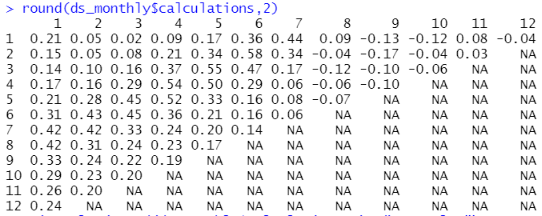
1 | 0.21 | 0.05 | 0.02 | 0.09 | 0.17 | 0.36 | 0.44 | 0.09 | -0.13 | -0.12 | 0.08 | -0.04
2 | 0.15 | 0.05 | 0.08 | 0.21 | 0.34 | 0.58 | 0.34 | -0.04 | -0.17 | -0.04 | 0.03
3 | 0.14 | 0.1 | 0.16 | 0.37 | 0.55 | 0.47 | 0.17 | -0.12 | -0.1 | -0.06
4 | 0.17 | 0.16 | 0.29 | 0.54 | 0.5 | 0.29 | 0.06 | -0.06 | -0.1
5 | 0.21 | 0.28 | 0.45 | 0.52 | 0.33 | 0.16 | 0.08 | -0.07
6 | 0.31 | 0.43 | 0.45 | 0.36 | 0.21 | 0.16 | 0.06
7 | 0.42 | 0.42 | 0.33 | 0.24 | 0.2 | 0.14
8 | 0.42 | 0.31 | 0.24 | 0.23 | 0.17
9 | 0.33 | 0.24 | 0.22 | 0.19
10 | 0.29 | 0.23 | 0.2
11 | 0.26 | 0.2
12 | 0.24
Output matrix
with correlation
Coefficients.
35

Slide 36
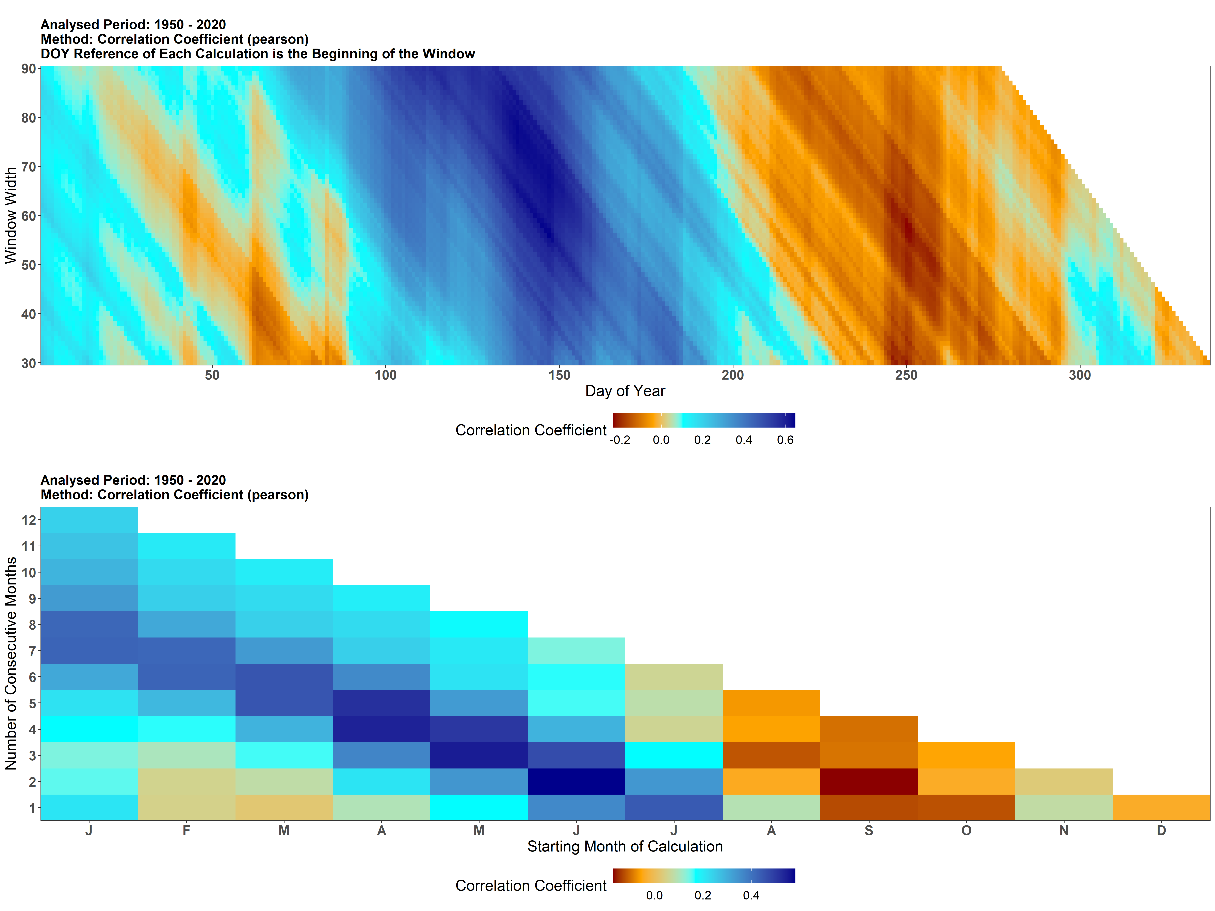
1 | 0.21 | 0.05 | 0.02 | 0.09 | 0.17 | 0.36 | 0.44 | 0.09 | -0.13 | -0.12 | 0.08 | -0.04
2 | 0.15 | 0.05 | 0.08 | 0.21 | 0.34 | 0.58 | 0.34 | -0.04 | -0.17 | -0.04 | 0.03
3 | 0.14 | 0.1 | 0.16 | 0.37 | 0.55 | 0.47 | 0.17 | -0.12 | -0.1 | -0.06
4 | 0.17 | 0.16 | 0.29 | 0.54 | 0.5 | 0.29 | 0.06 | -0.06 | -0.1
5 | 0.21 | 0.28 | 0.45 | 0.52 | 0.33 | 0.16 | 0.08 | -0.07
6 | 0.31 | 0.43 | 0.45 | 0.36 | 0.21 | 0.16 | 0.06
7 | 0.42 | 0.42 | 0.33 | 0.24 | 0.2 | 0.14
8 | 0.42 | 0.31 | 0.24 | 0.23 | 0.17
9 | 0.33 | 0.24 | 0.22 | 0.19
10 | 0.29 | 0.23 | 0.2
11 | 0.26 | 0.2
12 | 0.24
Output matrix
with correlation
Coefficients.
36

Slide 37
The algorithm for calculation of daily correlations

Slide 38
Tree-ring index
Climate (precipitation) data
Tree-ring index
Year | 1 | 2 | 3 | 4 | 5 | 6 | 7 | 8 | … | 364 | 365 | 366
1950 | 0 | 0 | 0 | 0 | 0 | 0 | 0 | 0 | … | 0 | 0
1951 | 4.1 | 12.5 | 8 | 7.2 | 0 | 0 | 0 | 0 | … | 0 | 0
1952 | 10.7 | 0 | 12.9 | 0 | 0 | 0 | 0 | 0 | … | 13.5 | 8.6 | 18.2
1953 | 12.4 | 3.7 | 1.3 | 0 | 0 | 4.6 | 0 | 0 | … | 0 | 0
1954 | 0 | 0 | 0 | 2.1 | 2.8 | 5.8 | 1.5 | 0 | … | 0 | 0
1955 | 0 | 0 | 0 | 2 | 0 | 10.2 | 10.5 | 2.5 | … | 9 | 5.8
… | … | … | … | … | … | … | … | … | … | … | … | …
2007 | 32.1 | 2.6 | 0 | 0 | 0 | 0 | 0 | 4.4 | … | 0 | 0
2008 | 0 | 0 | 0 | 6.5 | 25.7 | 9.4 | 0 | 0 | … | 0 | 0 | 5.3
2009 | 5.6 | 0 | 0 | 0 | 0 | 0 | 2.7 | 0 | … | 17.3 | 11.4
2010 | 5.2 | 5.2 | 0 | 9.9 | 11.8 | 5.4 | 0 | 33.4 | … | 0 | 0
2011 | 0 | 0 | 0 | 0 | 0 | 10.9 | 17 | 4.6 | … | 0 | 0
2012 | 0 | 29 | 3.5 | 0 | 0 | 0 | 0 | 0 | … | 0 | 0 | 0
2013 | 0 | 4.7 | 0 | 0 | 0 | 0 | 0 | 0 | … | 0 | 0
2014 | 0 | 14 | 4.1 | 57 | 12.2 | 0 | 0 | 0 | … | 0 | 0
2015 | 0 | 0 | 0 | 0 | 0 | 0 | 0 | 0 | … | 0 | 0
2016 | 0 | 21.4 | 1.1 | 5.5 | 14.4 | 0.8 | 0 | 10.4 | … | 0 | 0 | 0
2017 | 0 | 0 | 0 | 0 | 0 | 0 | 0 | 0 | … | 0 | 2.8
2018 | 28.9 | 0 | 2.6 | 0 | 10.7 | 4.9 | 0 | 0 | … | 0 | 0
2019 | 0 | 0 | 0 | 0 | 0 | 0 | 1.2 | 1.4 | … | 0 | 0
2020 | 0 | 0 | 0 | 0 | 0 | 0 | 0 | 0 | … | 21.1 | 0 | 0
Year | xxxres
1950 | 0.832574
1951 | 0.773547
1952 | 0.802538
1953 | 1.187925
1954 | 0.805322
1955 | 1.070598
… | …
2007 | 1.065947
2008 | 1.25593
2009 | 0.792385
2010 | 0.892232
2011 | 1.032739
2012 | 0.823726
2013 | 0.767191
2014 | 1.527352
2015 | 0.929998
2016 | 1.050544
2017 | 0.687902
2018 | 0.998284
2019 | 0.97128
2020 | 1.375464
Temporal average/sum
0
6.36
4.72
3.48
0.98
0.4
…
6.94
6.44
1.12
6.42
0
6.5
0.94
17.46
0
8.48
0
8.44
0
0
5 | 0.06 |  |  |  |  |  |  |  | …
6 |  |  |  |  |  |  |  |  | …
7 |  |  |  |  |  |  |  |  | …
8 |  |  |  |  |  |  |  |  | …
9 |  |  |  |  |  |  |  |  | …
10 |  |  |  |  |  |  |  |  | …
11 |  |  |  |  |  |  |  |  | …
12 |  |  |  |  |  |  |  |  | …
… |  |  |  |  |  |  |  |  | …
364 |  |  |  |  |  |  |  |  | …
365 |  |  |  |  |  |  |  |  | …
366 |  |  |  |  |  |  |  |  | …
Output matrix
with correlation
Coefficients.
38

Slide 39
Tree-ring index
Climate (precipitation) data
Tree-ring index
Year | 1 | 2 | 3 | 4 | 5 | 6 | 7 | 8 | … | 364 | 365 | 366
1950 | 0 | 0 | 0 | 0 | 0 | 0 | 0 | 0 | … | 0 | 0
1951 | 4.1 | 12.5 | 8 | 7.2 | 0 | 0 | 0 | 0 | … | 0 | 0
1952 | 10.7 | 0 | 12.9 | 0 | 0 | 0 | 0 | 0 | … | 13.5 | 8.6 | 18.2
1953 | 12.4 | 3.7 | 1.3 | 0 | 0 | 4.6 | 0 | 0 | … | 0 | 0
1954 | 0 | 0 | 0 | 2.1 | 2.8 | 5.8 | 1.5 | 0 | … | 0 | 0
1955 | 0 | 0 | 0 | 2 | 0 | 10.2 | 10.5 | 2.5 | … | 9 | 5.8
… | … | … | … | … | … | … | … | … | … | … | … | …
2007 | 32.1 | 2.6 | 0 | 0 | 0 | 0 | 0 | 4.4 | … | 0 | 0
2008 | 0 | 0 | 0 | 6.5 | 25.7 | 9.4 | 0 | 0 | … | 0 | 0 | 5.3
2009 | 5.6 | 0 | 0 | 0 | 0 | 0 | 2.7 | 0 | … | 17.3 | 11.4
2010 | 5.2 | 5.2 | 0 | 9.9 | 11.8 | 5.4 | 0 | 33.4 | … | 0 | 0
2011 | 0 | 0 | 0 | 0 | 0 | 10.9 | 17 | 4.6 | … | 0 | 0
2012 | 0 | 29 | 3.5 | 0 | 0 | 0 | 0 | 0 | … | 0 | 0 | 0
2013 | 0 | 4.7 | 0 | 0 | 0 | 0 | 0 | 0 | … | 0 | 0
2014 | 0 | 14 | 4.1 | 57 | 12.2 | 0 | 0 | 0 | … | 0 | 0
2015 | 0 | 0 | 0 | 0 | 0 | 0 | 0 | 0 | … | 0 | 0
2016 | 0 | 21.4 | 1.1 | 5.5 | 14.4 | 0.8 | 0 | 10.4 | … | 0 | 0 | 0
2017 | 0 | 0 | 0 | 0 | 0 | 0 | 0 | 0 | … | 0 | 2.8
2018 | 28.9 | 0 | 2.6 | 0 | 10.7 | 4.9 | 0 | 0 | … | 0 | 0
2019 | 0 | 0 | 0 | 0 | 0 | 0 | 1.2 | 1.4 | … | 0 | 0
2020 | 0 | 0 | 0 | 0 | 0 | 0 | 0 | 0 | … | 21.1 | 0 | 0
Year | xxxres
1950 | 0.832574
1951 | 0.773547
1952 | 0.802538
1953 | 1.187925
1954 | 0.805322
1955 | 1.070598
… | …
2007 | 1.065947
2008 | 1.25593
2009 | 0.792385
2010 | 0.892232
2011 | 1.032739
2012 | 0.823726
2013 | 0.767191
2014 | 1.527352
2015 | 0.929998
2016 | 1.050544
2017 | 0.687902
2018 | 0.998284
2019 | 0.97128
2020 | 1.375464
Temporal average/sum
0
5.54
2.58
1.92
2.14
2.44
…
0.52
8.32
0
6.46
2.18
6.5
0.94
17.46
0
8.64
0
3.64
0
0
5 | 0.06 | 0.01 |  |  |  |  |  |  | …
6 |  |  |  |  |  |  |  |  | …
7 |  |  |  |  |  |  |  |  | …
8 |  |  |  |  |  |  |  |  | …
9 |  |  |  |  |  |  |  |  | …
10 |  |  |  |  |  |  |  |  | …
11 |  |  |  |  |  |  |  |  | …
12 |  |  |  |  |  |  |  |  | …
… |  |  |  |  |  |  |  |  | …
364 |  |  |  |  |  |  |  |  | …
365 |  |  |  |  |  |  |  |  | …
366 |  |  |  |  |  |  |  |  | …
Output matrix
with correlation
Coefficients.
39

Slide 41
The importance of reference_window

Slide 42
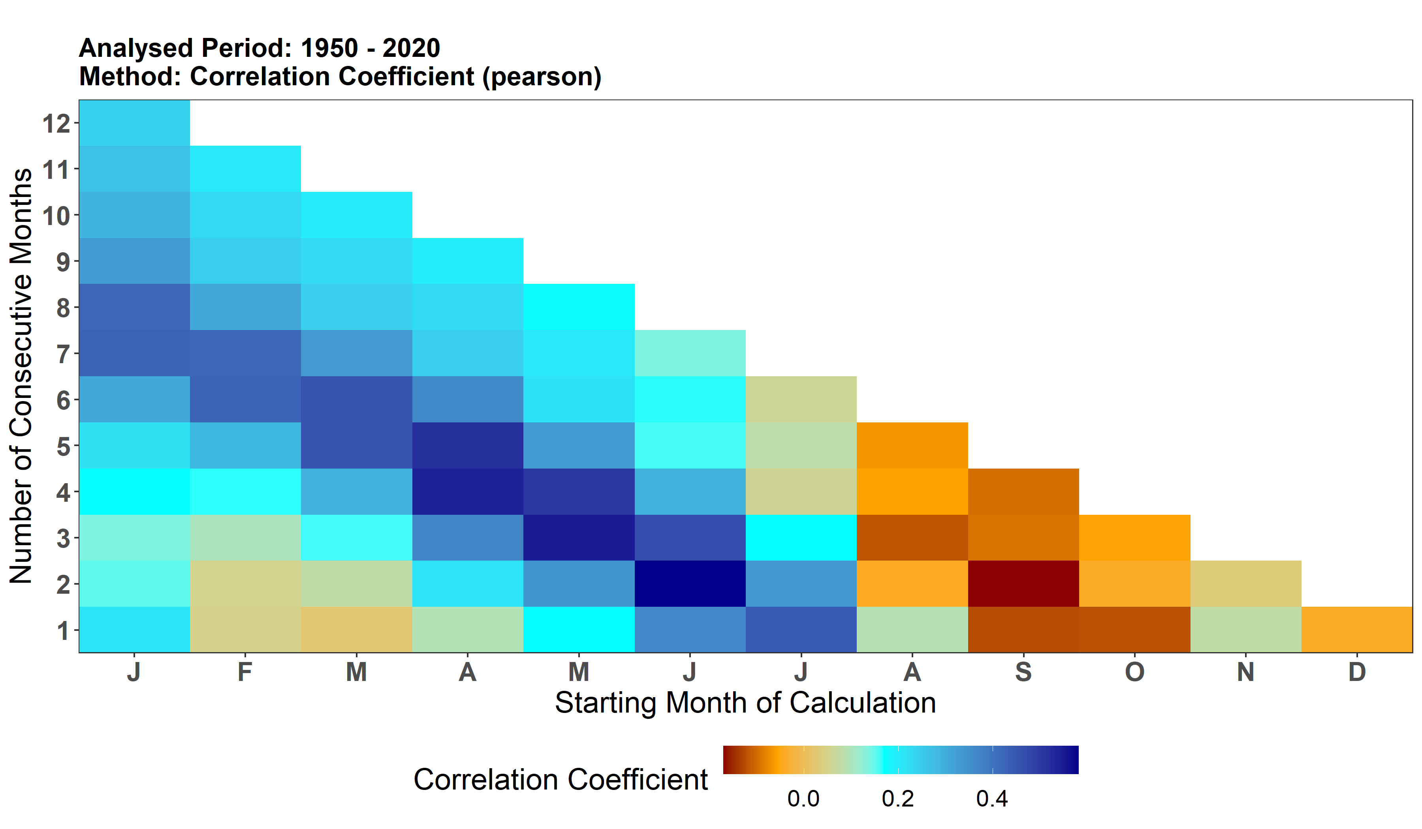
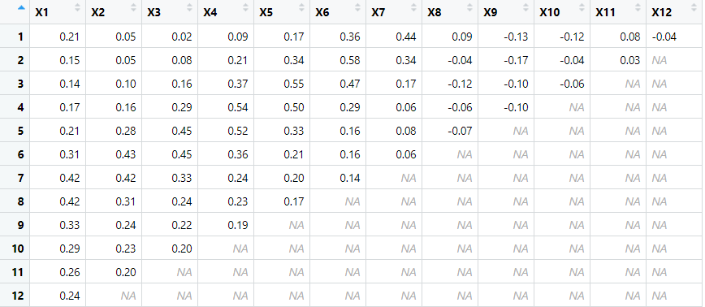
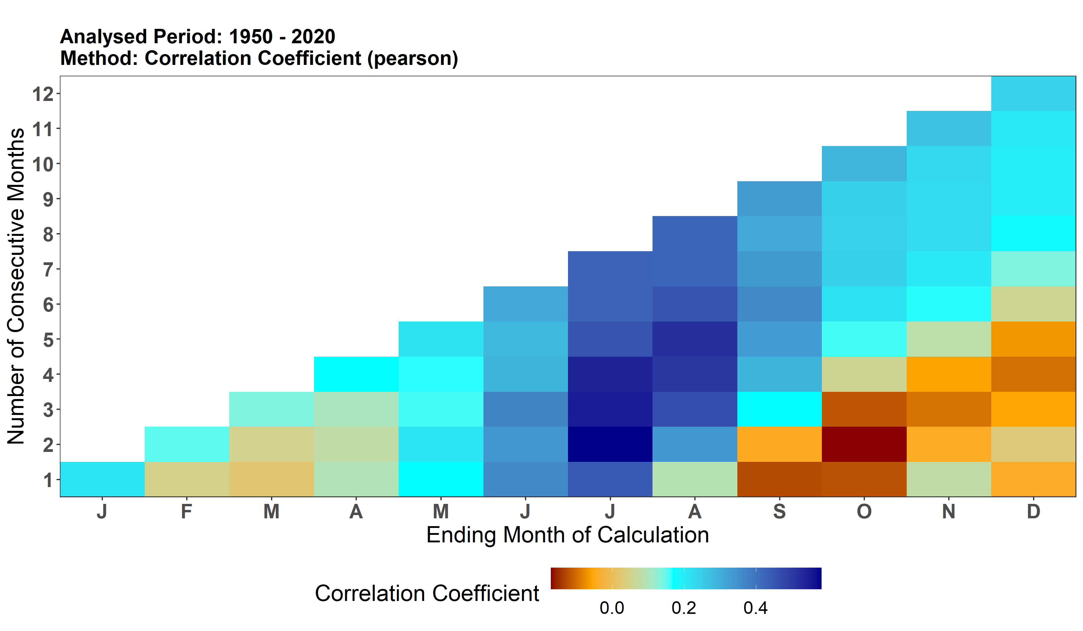
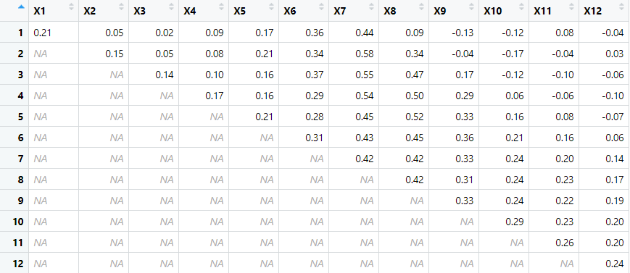
reference_window = "start"
reference_window = "end"

Slide 43
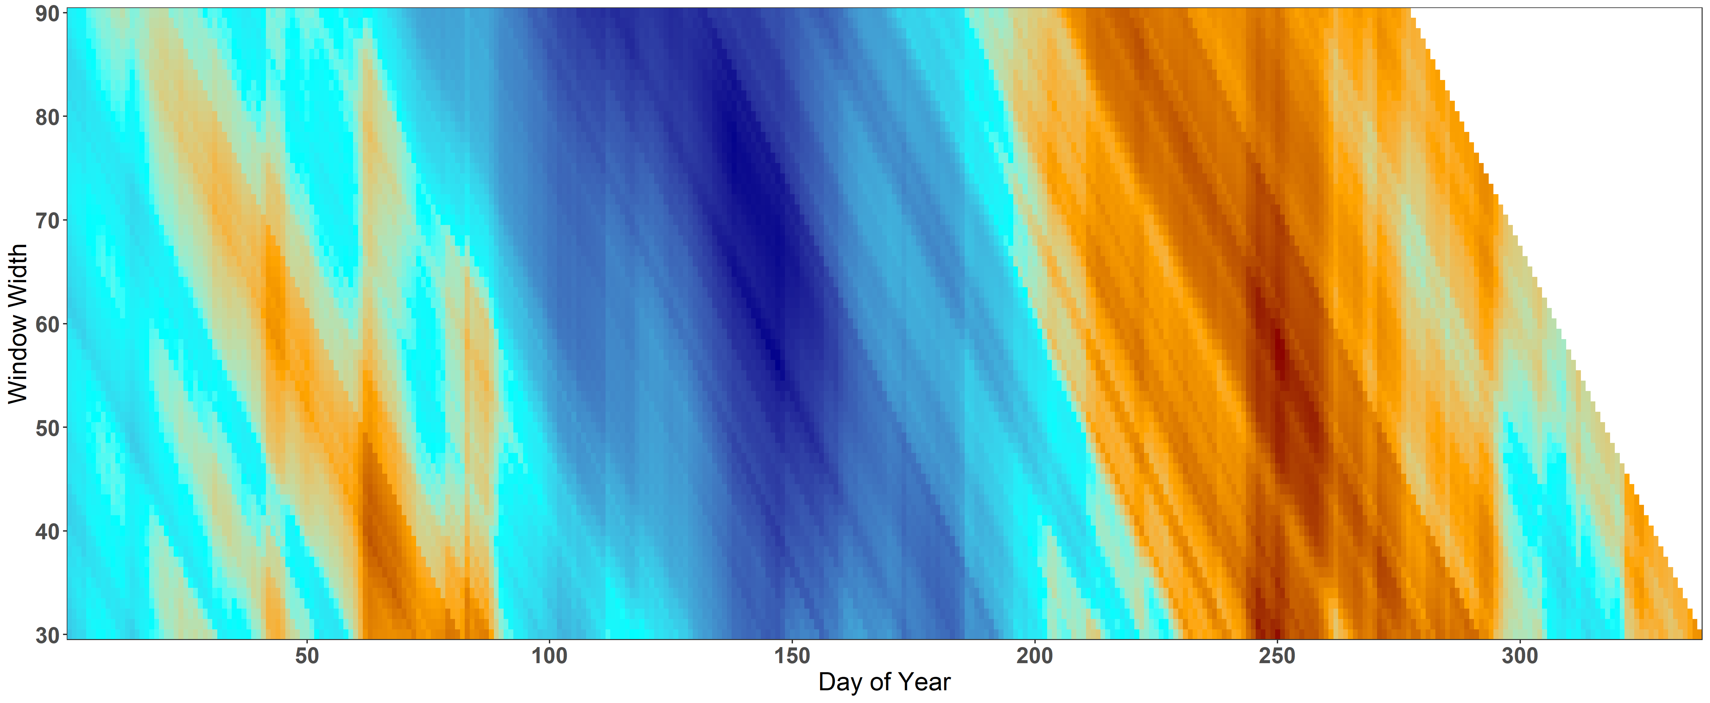
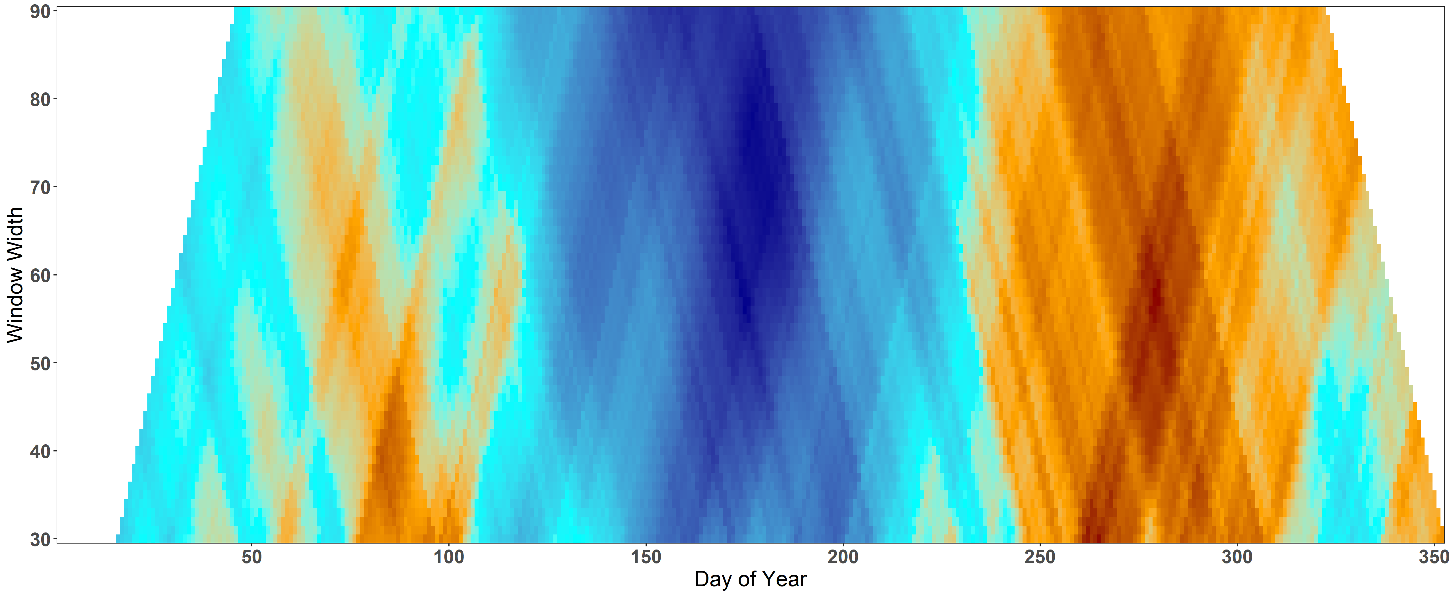
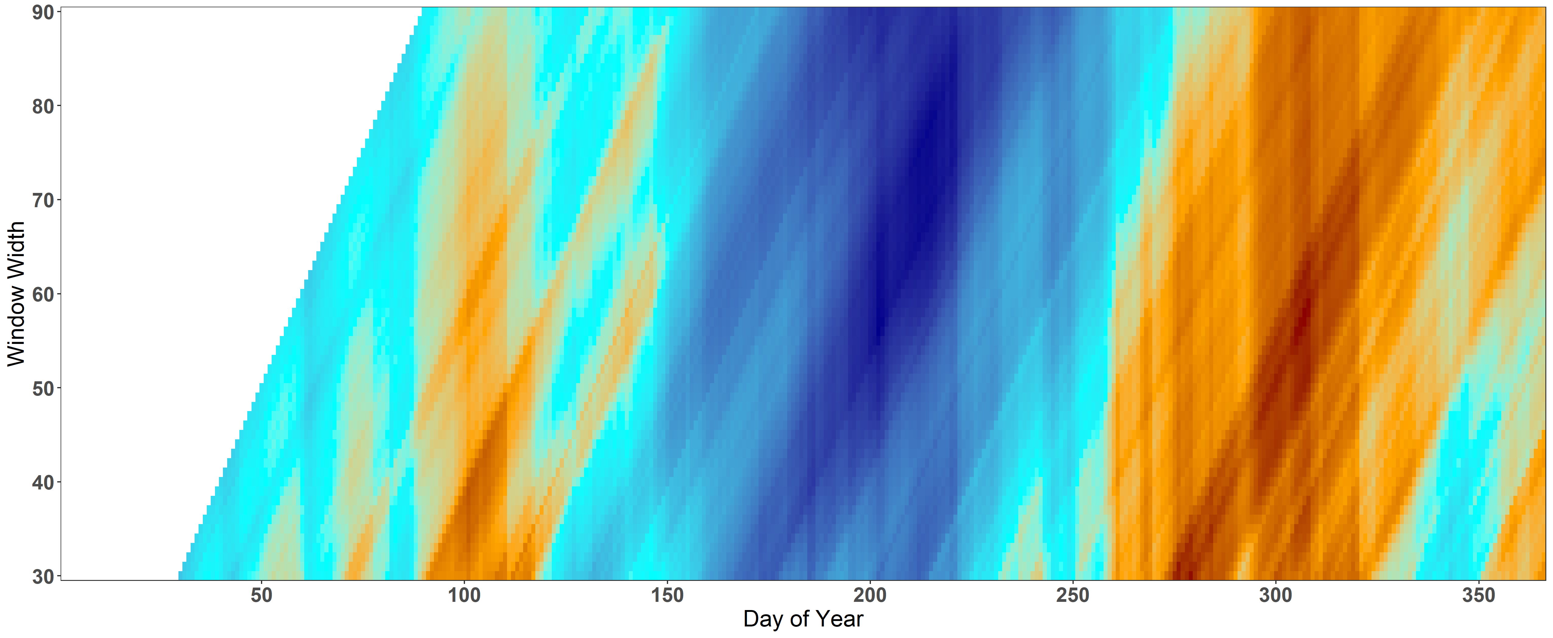
reference_window = "start"
reference_window = "middle"
reference_window = "end"

Slide 44
Filtering non-significant correlations based on the selected alpha

Slide 45
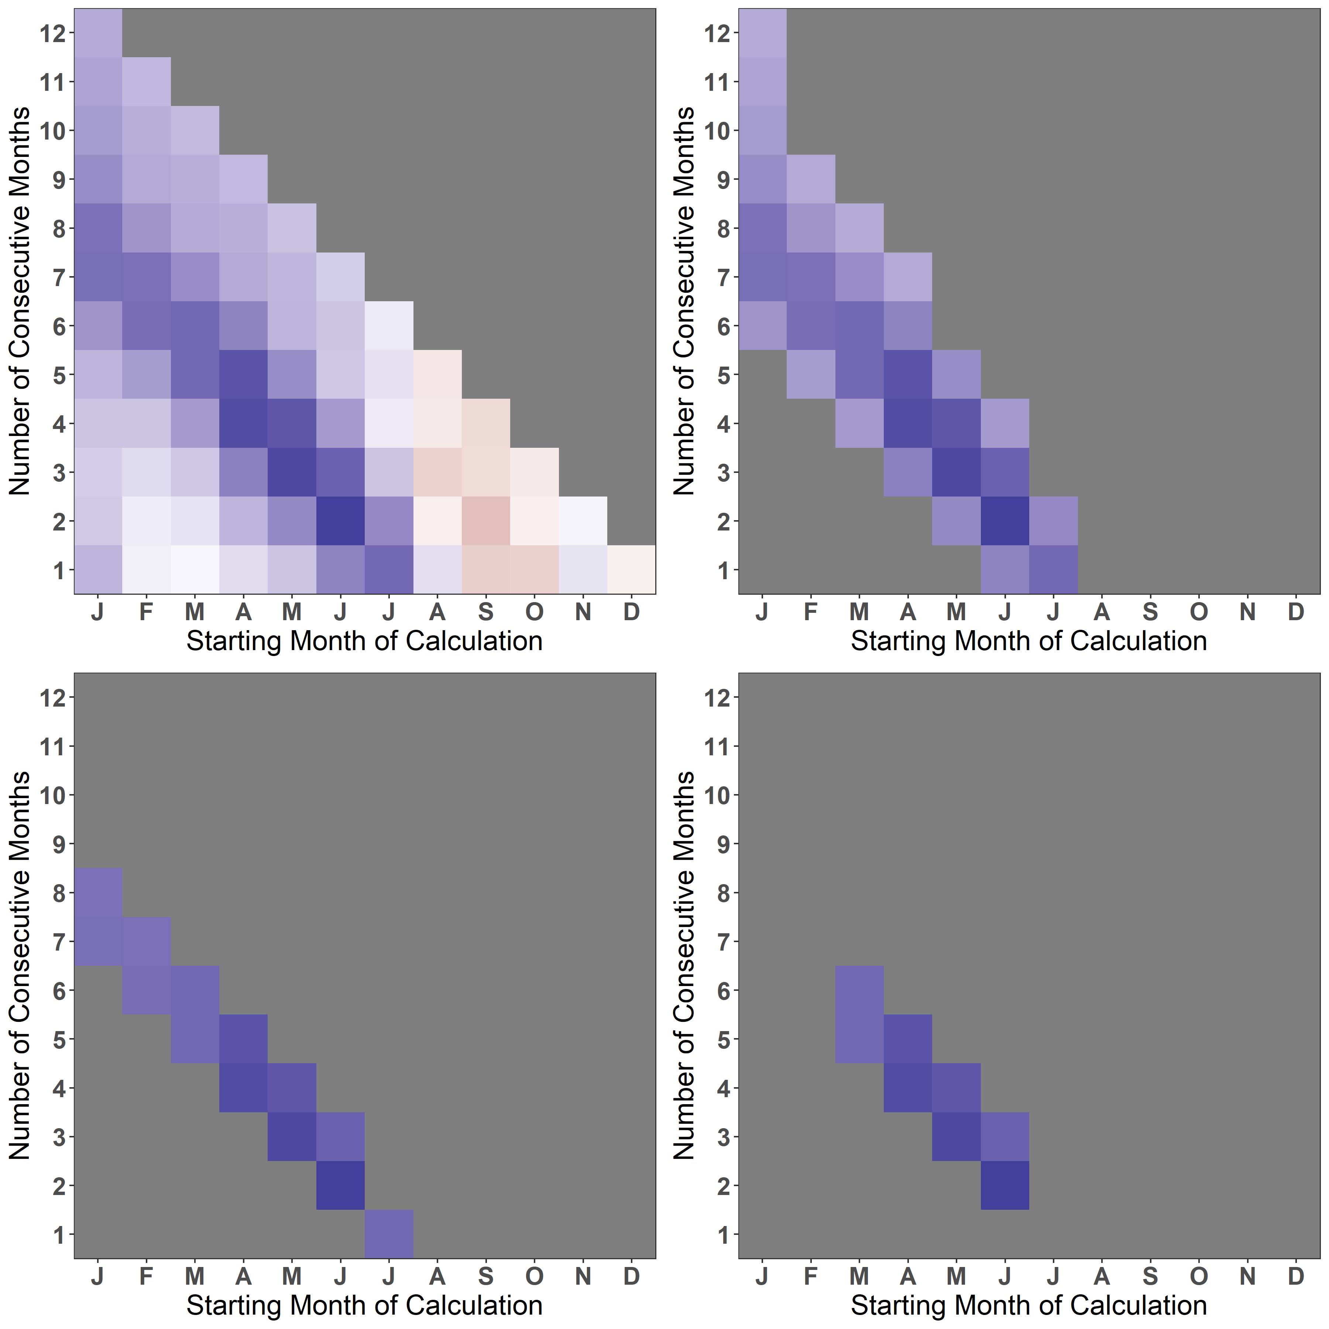
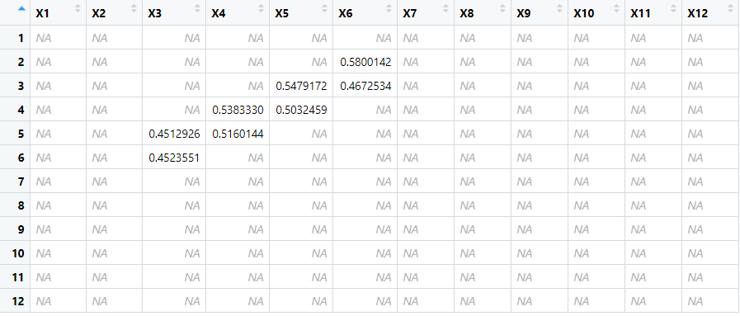

remove_insignificant = FALSE
alpha = 0.05
alpha = 0.0001
alpha = 0.001
alpha = 0.0001

Slide 46
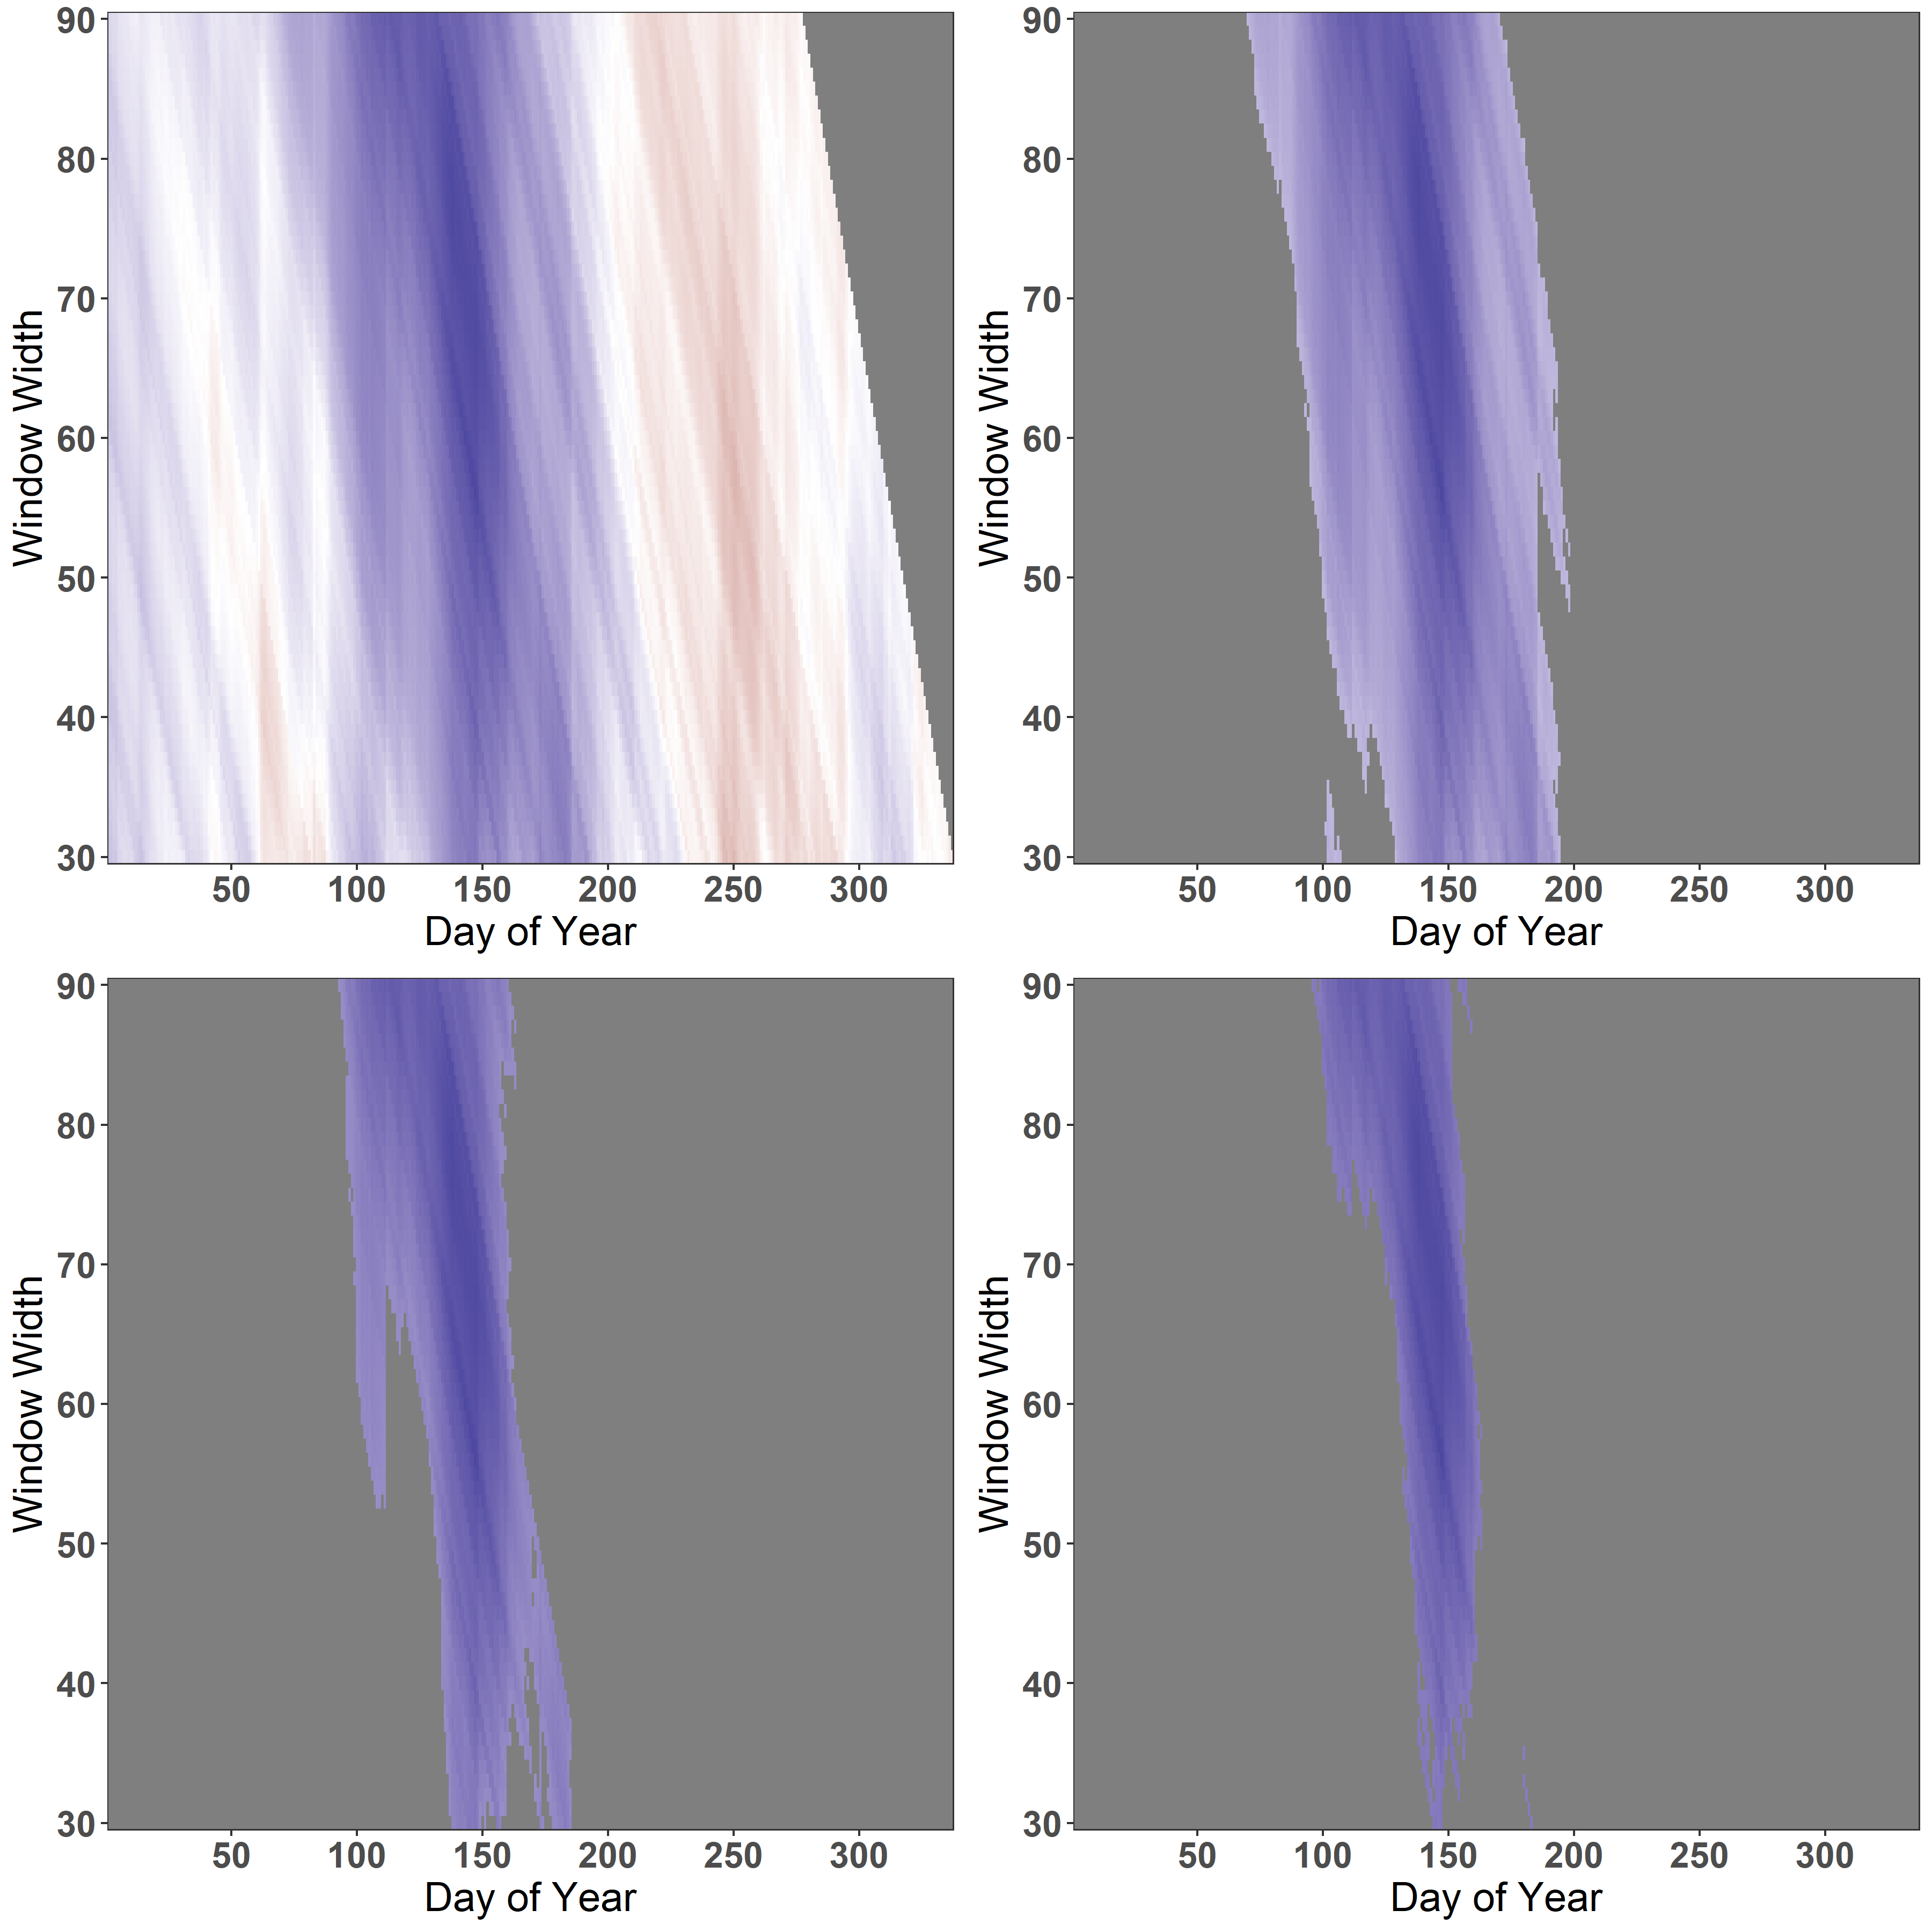
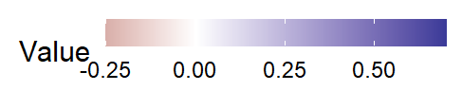
remove_insignificant = FALSE
alpha = 0.05
alpha = 0.001
alpha = 0.0001

Slide 47
Manually create heatmaps using ggplot2

Slide 48
Partial correlation coefficients

Slide 49
Partial Correlation Coefficient
A partial correlation coefficient describes the strength of a linear relationship between two variables, holding constant a number of other variables (Statistical Methods, 2022).
Important in dendroclimatology due to a very common correlation between temperature and precipitation.

Slide 50
Partial Correlation Coefficient
daily_response_seascorr()
- env_data_primary
- env_data control
- pcor_method = "pearson"
monthly_response_seascorr()
- env_data_primary
- env_data control
- pcor_method = "pearson"

Slide 51
Partial Correlation Coefficient – subset analysed period
daily_response_seascorr()
- day_interval()
monthly_response_seascorr()
- month_interval()

Slide 52
Why is climate detrending needed?
Increasing temperatures in recent five decades
Simple Linear Detrending : dc_climate = "SLD„

Slide 53
Temporal stability of correlations

Slide 54
Detrending climate

Slide 55
Why is climate detrending needed?
Increasing temperatures in recent five decades

Slide 56
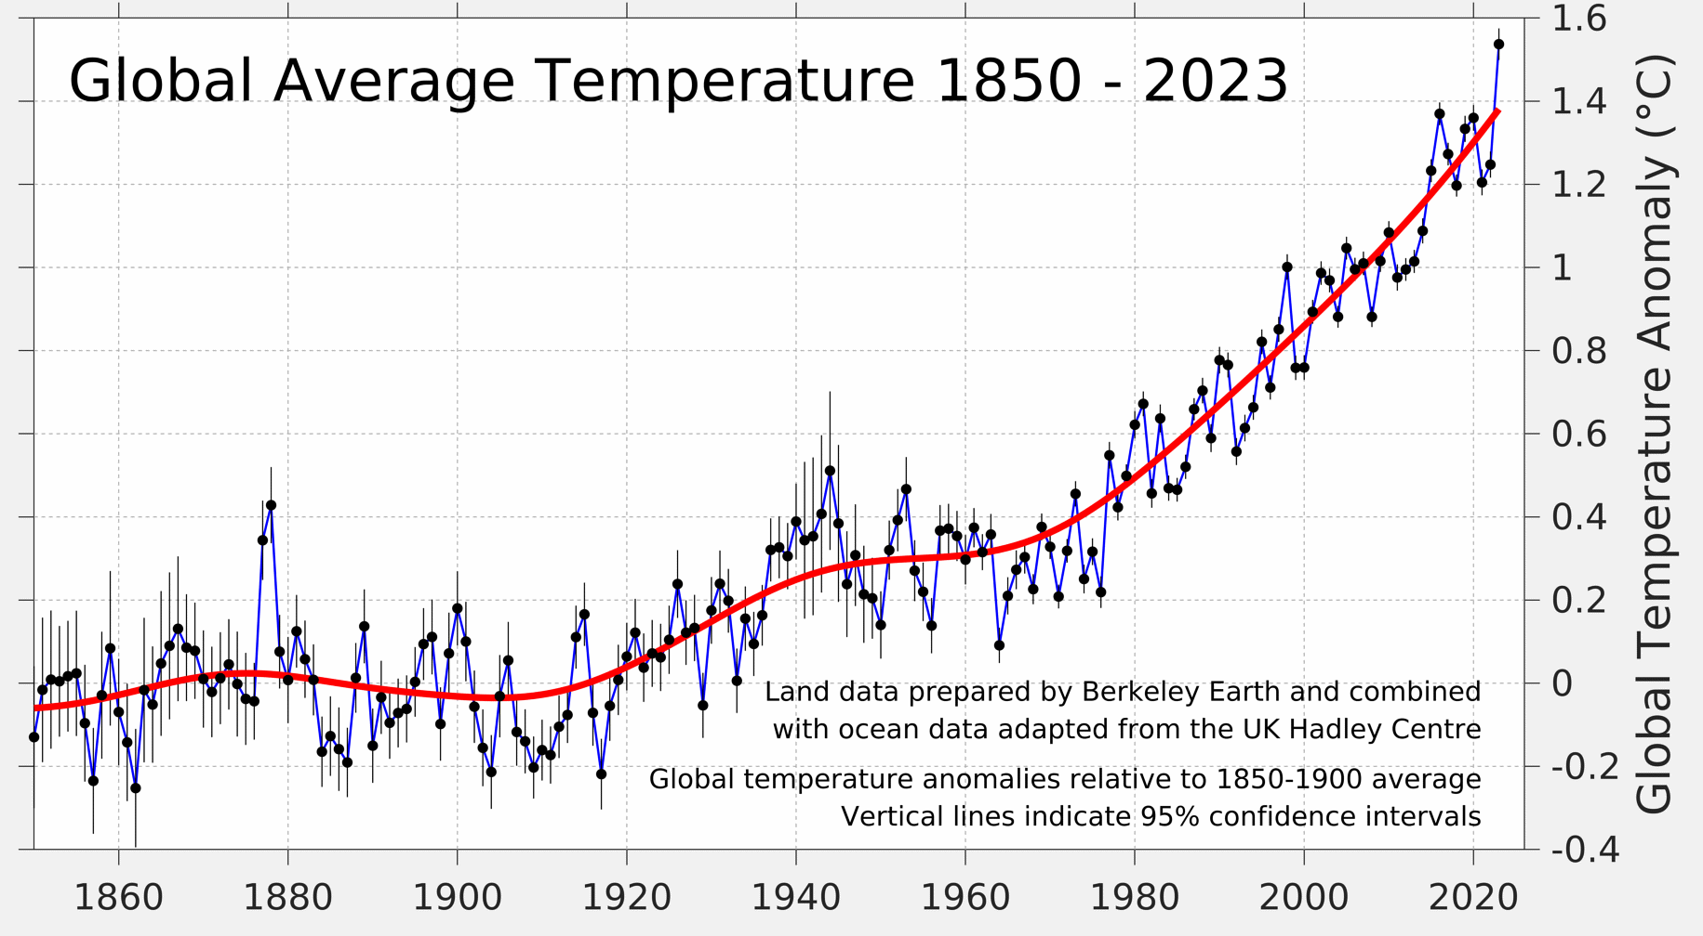
Why is climate detrending needed?
Increasing temperatures in recent five decades

Slide 57
Standardized Precipitation-Evapotranspiration Index (SPEI) analyses with dendroTools

Slide 58
SPEI
SPEI is designed to consider both precipitation and potential evapotranspiration (PET) in determining drought.
SPEI is based on the water balance (WB) which is a simple difference between precipitation and PET.
WB is then integrated into different time scales indicating drought for different periods.

Slide 59
rTG R package
Jernej Jevšenak
Brasov, June 4, 2024

Slide 60
rTG – radial tree growth R package
R package to assist the analysis in the field of wood formation
The primary goal is to derive the temporal dynamics of secondary growth (xylem and phloem)
Photo by Peter Prislan

Slide 61
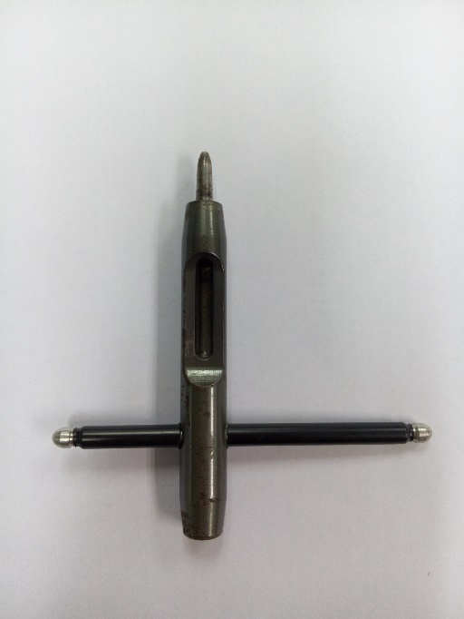
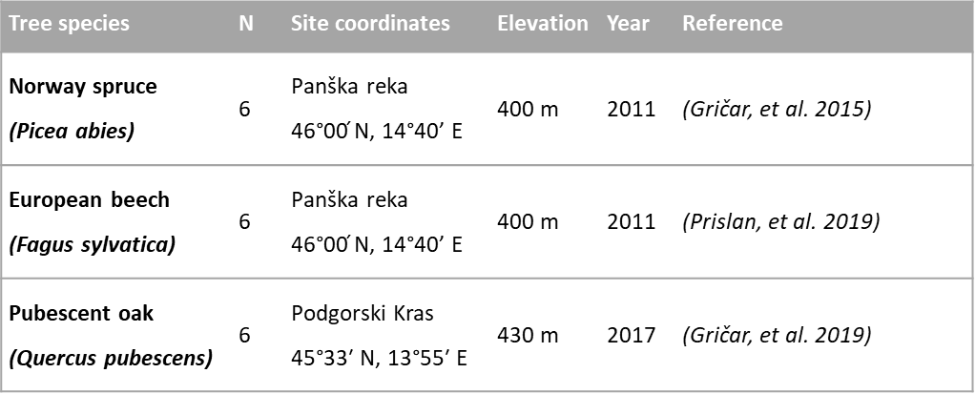
Monitoring of secondary tree growth
Examples on Quercus pubescens, Fagus sylvatica and Picea abies
Guo et al., 2017 (DOI: 10.17521/cjpe.2017.0009)

Slide 62
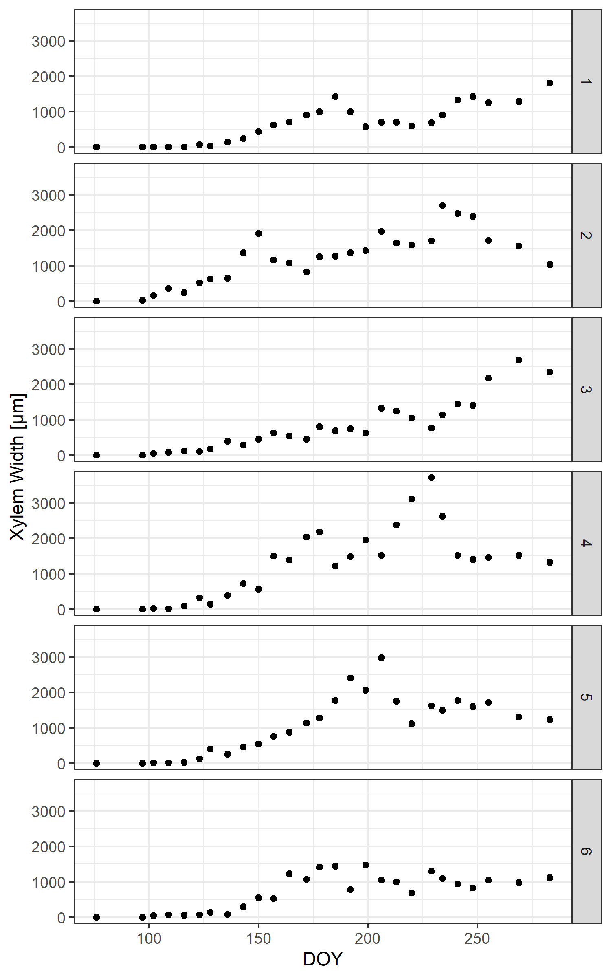
rTG – radial tree growth R package
Sampling did not capture the onset and cessation of cambium activity
Radial growth around the circumference is usually heterogeneous
Estimations should include winter cambium dormancy prior to growth reactivation in spring, and after the cambial cessation in late summer.
The derived function is expected to be strictly monotone, with constant values prior to and after the end of cambial cell production.
The same function should be flexible enough to appropriately capture the bimodal xylem growth often observed in Mediterranean climates.

Slide 63
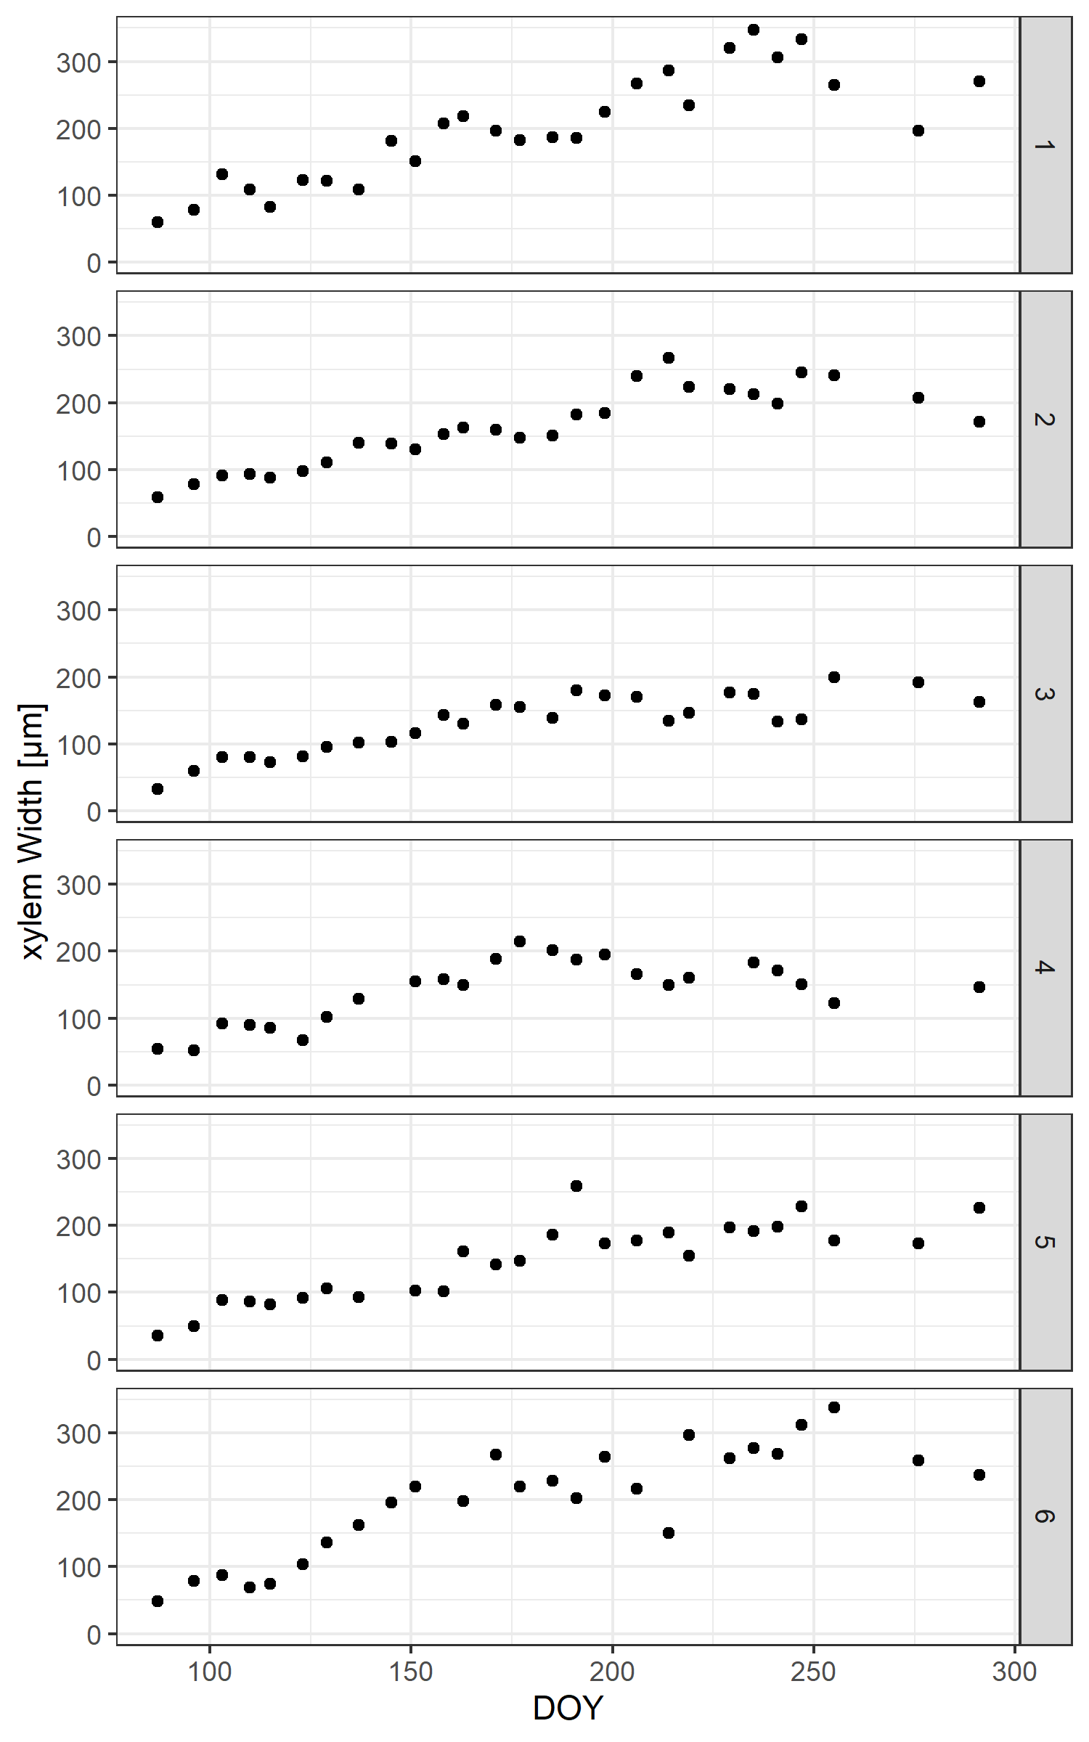
rTG – radial tree growth R package
Sampling did not capture the onset and cessation of cambium activity
Radial growth around the circumference is usually heterogeneous
Estimations should include winter cambium dormancy prior to growth reactivation in spring, and after the cambial cessation in late summer.
The derived function is expected to be strictly monotone, with constant values prior to and after the end of cambial cell production.
The same function should be flexible enough to appropriately capture the bimodal xylem growth often observed in Mediterranean climates.

Slide 64
The most common methods for deriving the temporal dynamics of secondary tree growth
Gompertz function
one of the most used sigmoid models
a common approach for modelling xylem and phloem formation
disadvantage is the need to select initial parameters
it often exhibits convergence problems when observations are highly variable
it is less suitable for the modelling of phloem growth due to the high growth rates at the beginning of the growing season
unable to model bimodal growth
parameters
a - represents asymptote or ultimate limiting value
b - represents displacement on the x axis
k - growth constant

Slide 65
The most common methods for deriving the temporal dynamics of secondary tree growth
Gompertz function
General additive models (GAMs)
a semi-parametric extension of generalized linear models (GLMs)
more flexible GAMs can better fit wood formation data
often fail to meet the desired constant behavior prior to and after the growing season
the final model could exhibit negative increments
the flexibility of GAM is determined by k and sp parameters
k represent the number of basis functions, while sp is smoothing parameter

Slide 66
The most common methods for deriving the temporal dynamics of secondary tree growth
Gompertz function
General additive models (GAMs)
a semi-parametric extension of generalized linear models (GLMs)
more flexible GAMs can better fit wood formation data
often fail to meet the desired constant behavior prior to and after the growing season
the final model could exhibit negative increments
the flexibility of GAM is determined by k and sp parameters
k represent the number of basis functions, while sp is smoothing parameter

Slide 67
The most common methods for deriving the temporal dynamics of secondary tree growth
Gompertz function
General additive models (GAMs)
Artificial Neural Networks (ANN)
Flexible, nonlinear brain-like structures
A multilayer perceptron consists of an input, a hidden, and an output layer
A backpropagation learning algorithm -> a process, where input-output pairs are presented to the network, and weights are adjusted to minimize the error between network output and actual value
ANNs based on Bayesian regularization algorithm (BRNN) prevents overfitting and usually results in a sigmoid-shaped function
The flexibility is determined by the neurons parameter

Slide 68
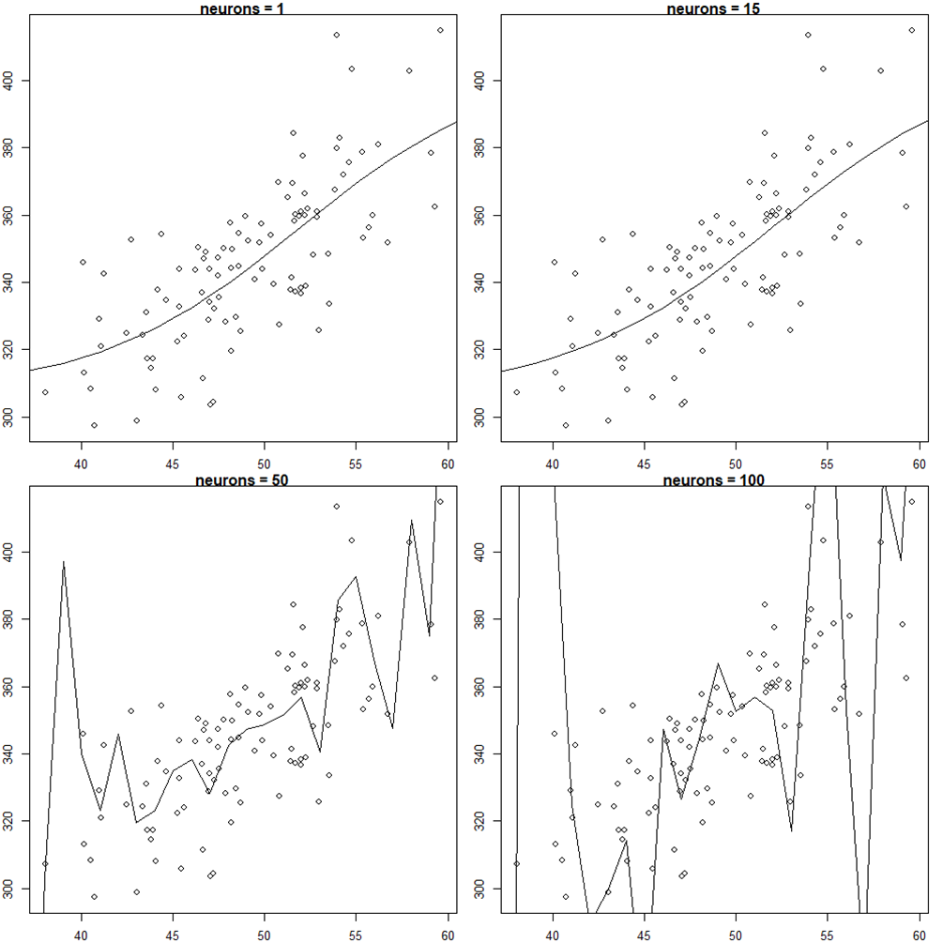
The concept of overfitting

Slide 69
rTG R package
The radial Tree Growth (rTG v1.0.1) R package was developed for deriving temporal dynamics of secondary tree growth, obtained from seasonal xylem and phloem widths or cell numbers.
Freely available under the GPL 3.0 license from CRAN
Can be installed using the standard command >install.packages("rTG") >install_github("jernejjevsenak/rTG")
Based on the core function XPSgrowth() and two generic S3 functions, i.e. plot() and summary()

Slide 70
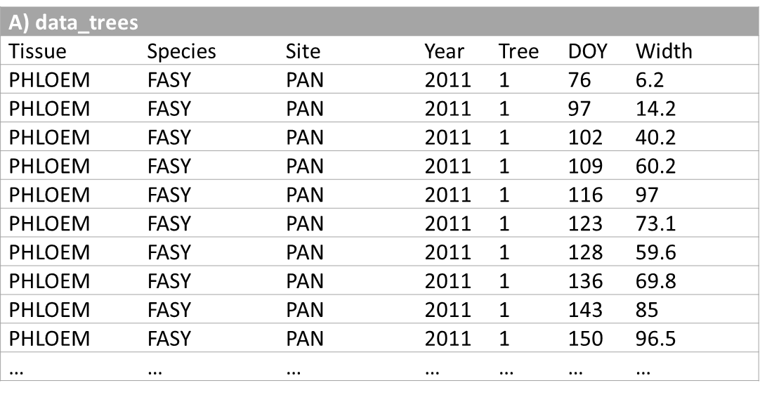
The XPSgrowth() function
Can be used to compare and select fitting methods on xylem or phloem formation data to describe the temporal dynamics of secondary growth
Input data
A) data_trees with selected ID variables and two additional variables: "DOY" represents day of a year, and "Width" is the target variable, which usually represents the number of radial cells (conifers) or radial width in µm (broadleaves). The "Sample" variable is optional.

Slide 71
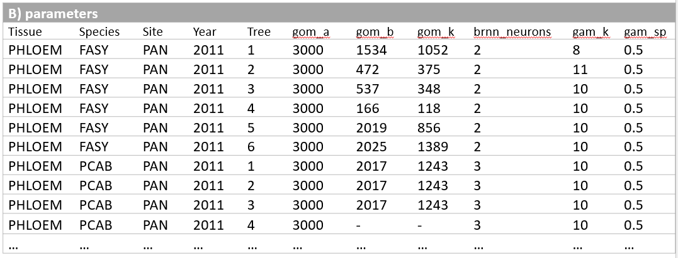
The XPSgrowth() function
Can be used to compare and select fitting methods on xylem or phloem formation data to describe the temporal dynamics of secondary growth
Input data
B) data frame parameters consist of selected ID variables and specified parameter values for the considered fitting methods

Slide 72
The XPSgrowth() function
Key parameters
data_trees and parameters are input data
search_initial_gom logical, should the algorithm to search initial Gompertz parameters be applied?
fitting_method vector of one or more methods to be compared: "gompertz", "gam", "brnn"
ID_vars character vector of variables which indicate column names of ID variables
fitted_save logical, should the fitted curves be saved in current working directory?
add_zeros logical, should zero observations at the beginning of growing season be added?
add_zeros_before if 'min' (character) then zeros will be added prior to the first observation in each year. Alternatively, users can specify absolute DOY prior which zeros will be added.
post_process logical, should the post-process algorithm be applied?

Slide 73
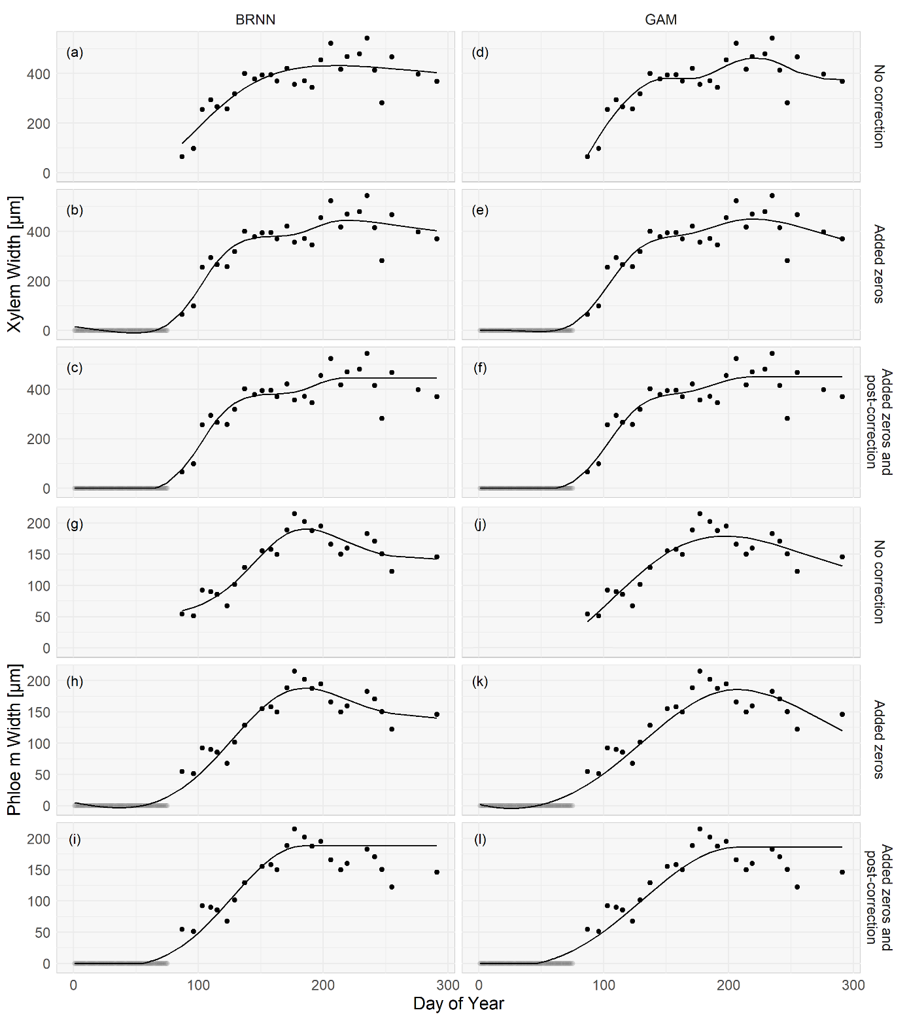
The XPSgrowth() function
The effect of adding zeros at the beginning of a growing season and the post-process algorithm

Slide 74
The XPSgrowth() function
Example R code
> library(rTG)
> data(parameters); data(data_trees)
> simulation_1 <- XPSgrowth(data_trees, parameters,
ID_vars = c("Species", "Tissue", "Site", "Year", "Tree"),
fitting_method = c("brnn", "gam", "gompertz"),
search_initial_gom = TRUE, fitted_save = TRUE,
add_zeros = TRUE, add_zeros_before = "min",
post_process = TRUE)
> plot(simulation_1)
> summary (simulation_1)

Slide 75
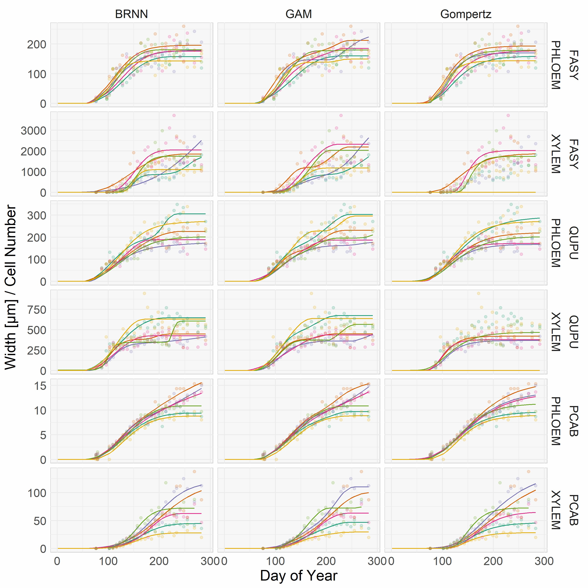

Slide 76
Exercises wtih the rTG

Slide 77
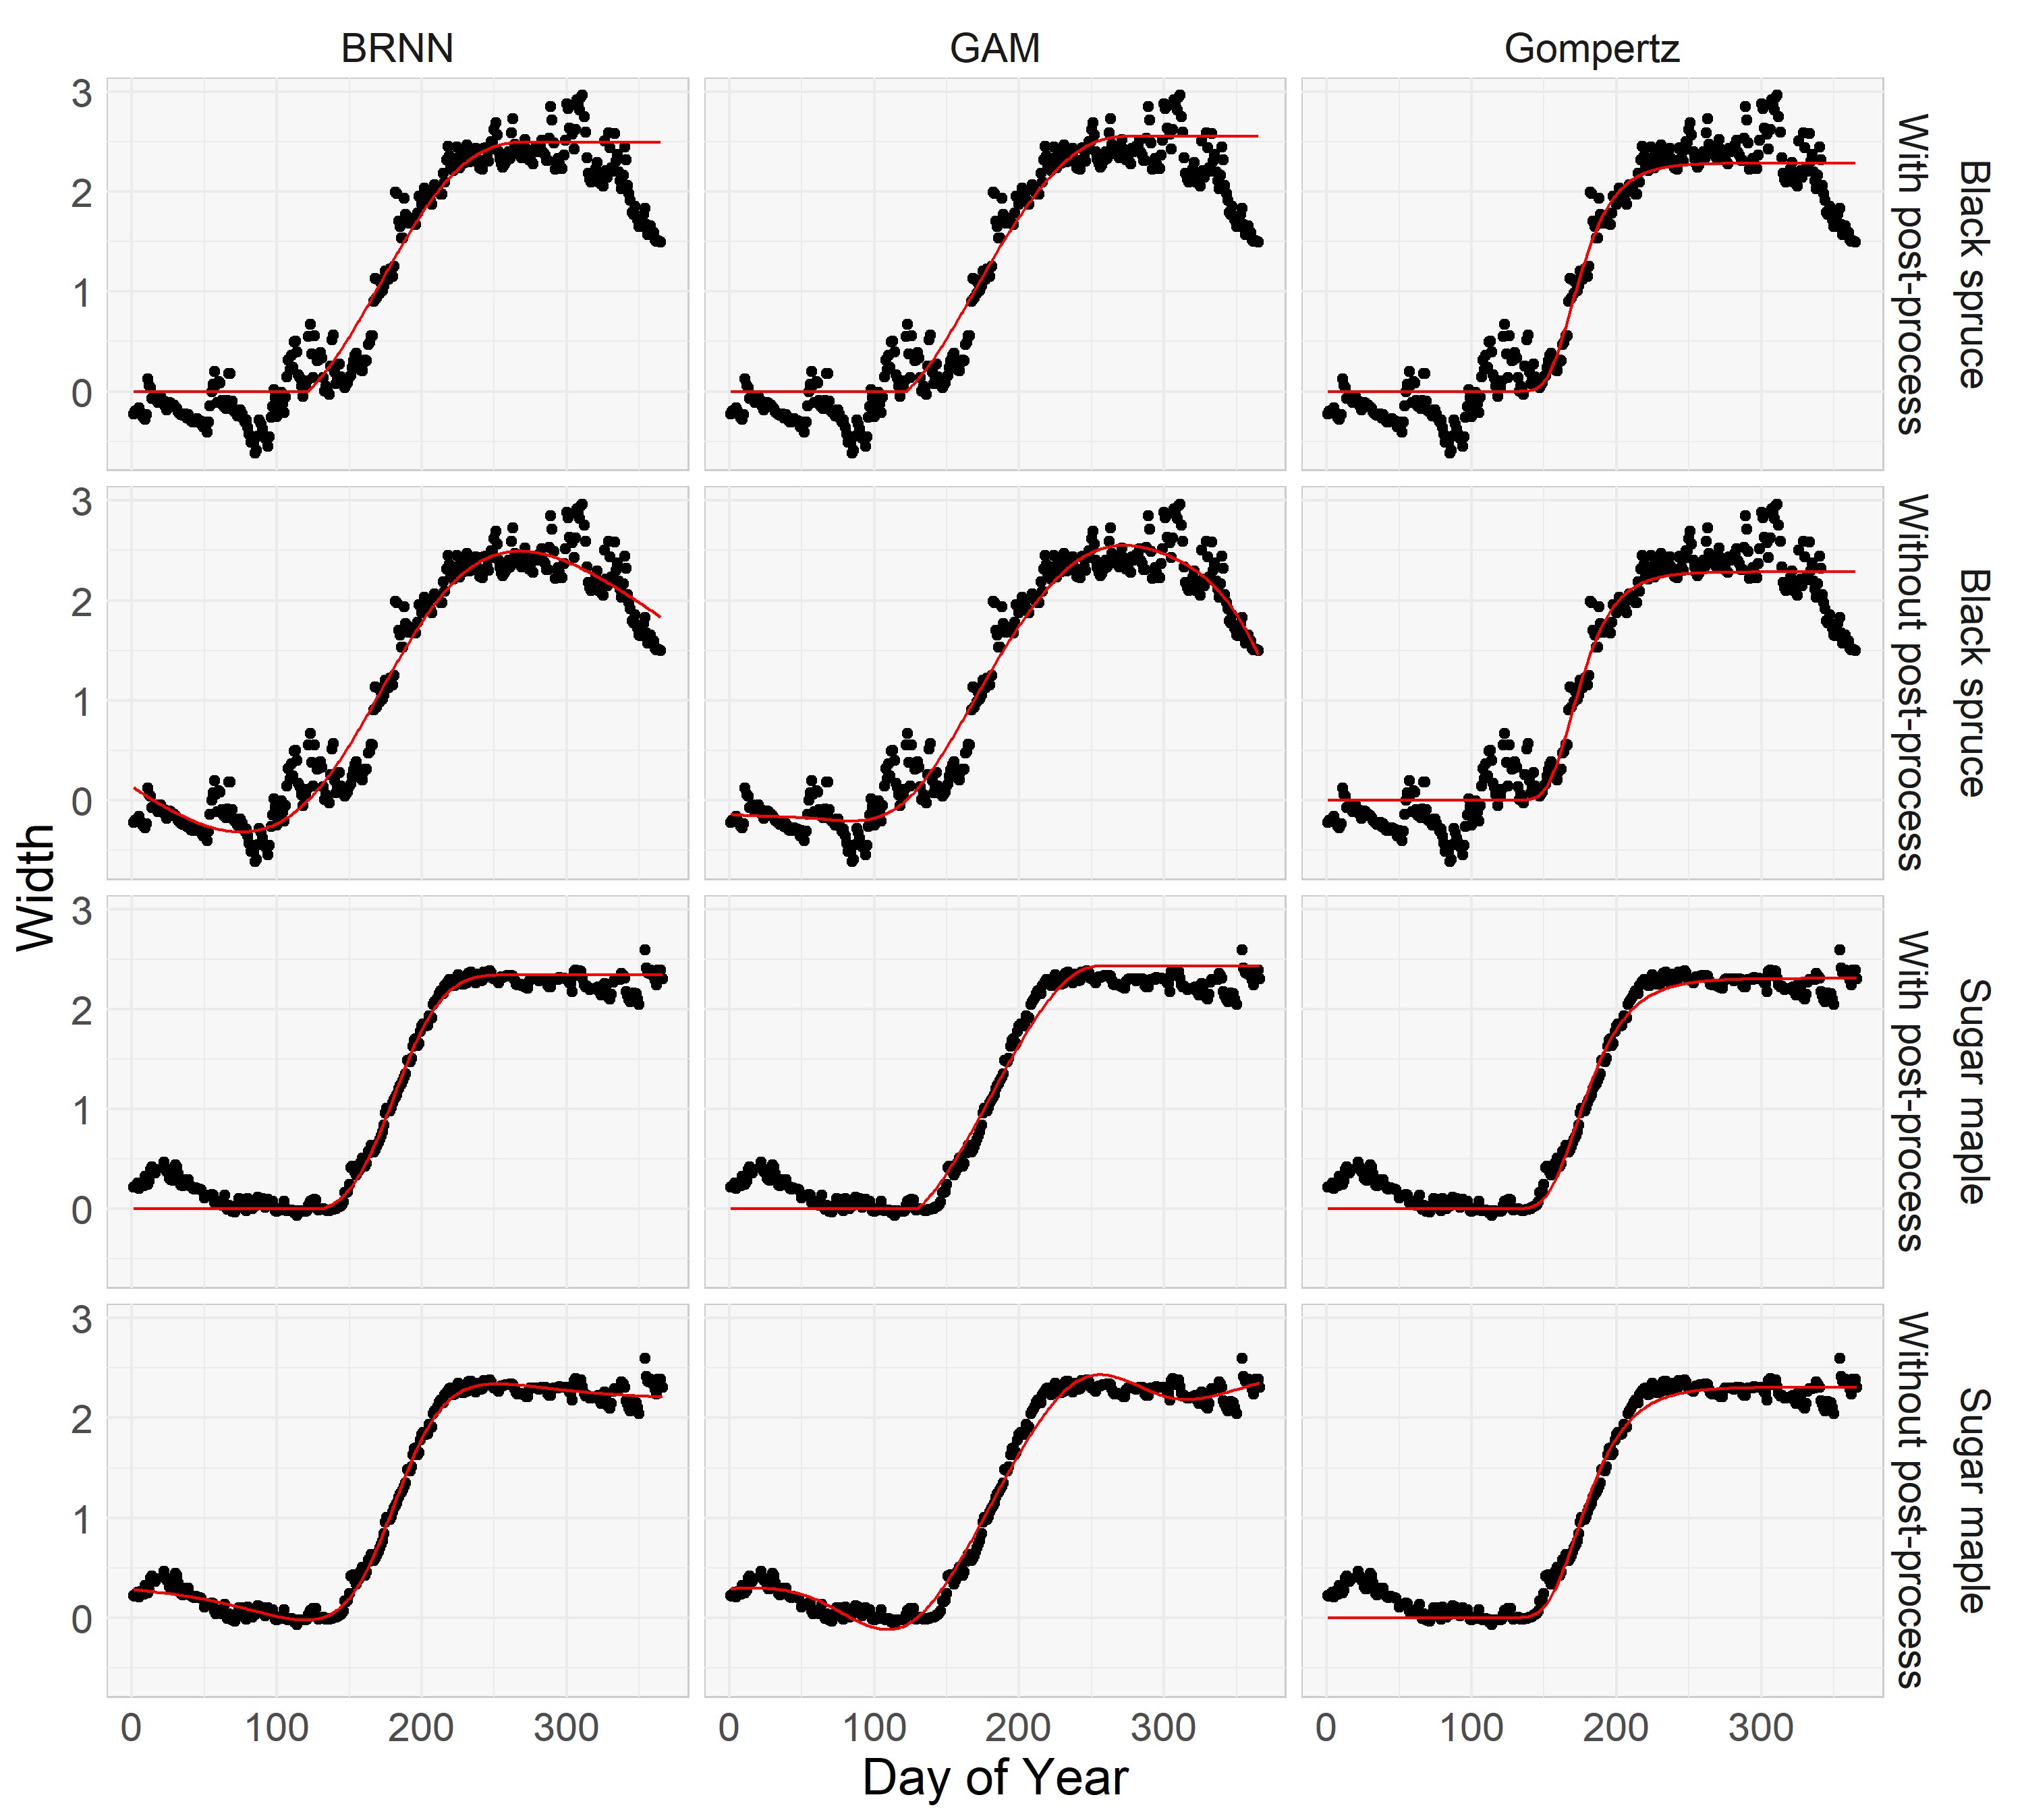
The XPSgrowth() applied on dendrometer data

Slide 78
That‘s all folks!
Any questions?
You can find me at: jernej.jevsenak@gozdis.si

